Slide 1
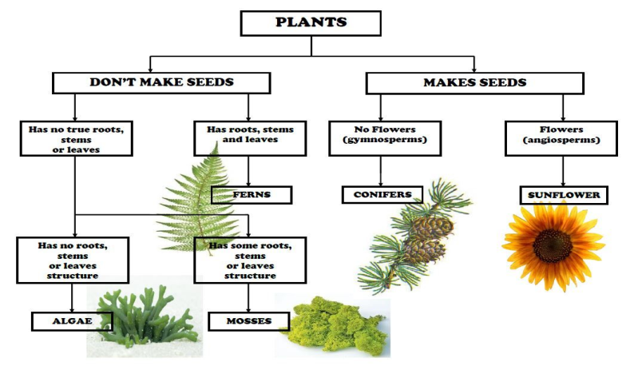
Science Focus | Living Things and their Habitats | Year 6
What? (Key Knowledge)
Habitats
Environment | Identify and name a variety of common animals that are birds, fish, amphibians, reptiles and mammals and the differences in their environments.
Food chains and their significance | Food chains are a map of the flow of energy from a plant (primary producer) through consumers, (primary consumers) and hunters Classifying Plants and Animals (secondary consumers).
Describe, compare and contrast | Describe and compare the structure of a variety of common animals (birds, fish, amphibians, reptiles and mammals, and including pets). Identify, name, draw and label food chains and ecosystems.
Living Things
Identify and show understanding of the differences between living things | Invertebrates (e.g. crab, worm) Fish (e.g. goldfish, cod, shark) Amphibians (e.g. frog, toad) Reptiles (e.g. snake, crocodile) Birds (e.g. robin, chicken, owl) Mammals (e.g. human, dog) Plants Micro-organisms
Classify and Identify | Identify and name a variety of common animals and plants and classify them under a set of specific criteria
Statutory requirements
Pupils should be taught to: Describe how living things are classified into broad groups according to common observable characteristics and based on similarities and differences, including microorganisms, plants and animals Give reasons for classifying plants and animals based on specific characteristics
What? (Key vocab)
Spelling | Definition
Organism | An individual living thing, such as a plant, an animal, or a bacteria.
Classifying | To put into groups according to things that are similar.
Unique | Being the only one of its type.
Vertebrate | Having a backbone
Invertebrate | Without a backbone
Mammal | Any animal that has hair and feeds its babies with milk from the mother.
Ecosystem | A community of living things, together with their environment.
Habitat | The natural environment of an animal or plant
Food chain | A series of living beings in which each serves as food for the next.
Possible experiences
Finding and classifying animals in the school environment Looking closely at the features of animals using hand lenses Visit from the ‘animal person’ to introduce less common animals (snakes and reptiles, spiders) Design a set of identification cards. Pupils in the school to classify and identify animals and plants in the school and local environment
Diagrams and Pictures

