Slide 1
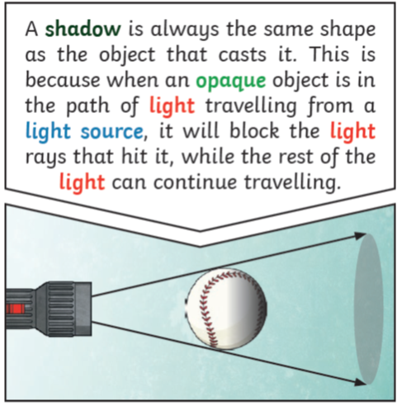
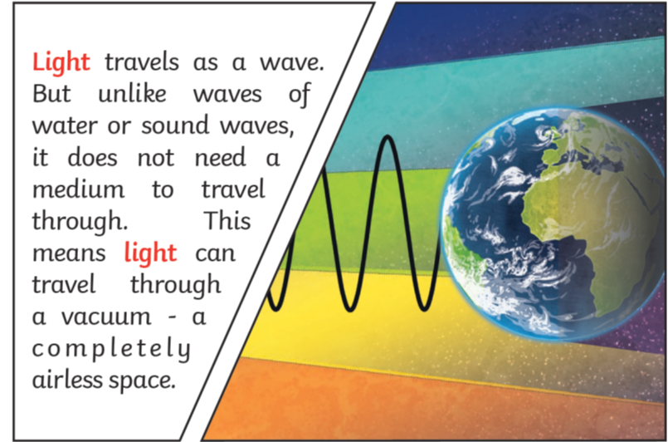
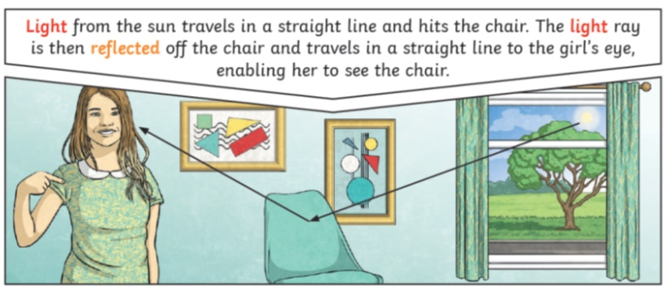
Science Focus | Light | Year 6 | Spring 1
What? (Key Knowledge)
Light
We need light to be able to see things. Light waves travel out from sources of light in straight lines. These are often called rays or beams of light.
How shadows are cast?
Light travelling through objects
Transparent Translucent Opaque | Describes objects that let light travel through them easily, meaning you can see through the object. Describes objects that things les some light through, but scatters the light so we can’t see them properly. Describes objects that do not let any light pass through them.
What? (Key vocab)
Spelling | Definition
Light | A form of energy that travels in a wave from a source.
Light source | An object that makes its own light.
Reflection | Reflection is when light bounces off a surface, changing the direction of a ray of light.
Refraction | Refraction happens when objects slow down the light beam and it deflects from its path (slightly changes its direction).
Shadow | A dark area or shape produced by a body coming between rays of light and a surface.
Statutory requirements
recognise that light appears to travel in straight lines. use the idea that light travels in straight lines to explain that objects are seen because they give out or reflect light into the eye. explain that we see things because light travels from light sources to our eyes or from light sources to objects and then to our eyes. use the idea that light travels in straight lines to explain why shadows have the same shape as the objects that cast them.
Possible experiences
Making a kaleidoscope or/and periscope Investigate how much light passes through different materials Use increased knowledge to create protective systems against too much light.

