Slide 1
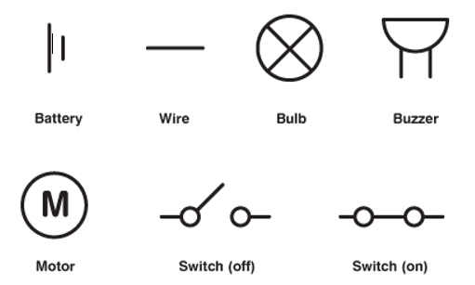
Science Focus | Electricity | Year 6 | Autumn 2
What? (Key Knowledge)
Electricity is a form of energy. Energy is needed to make things happen.
Electrons are small particles with a negative electric charge
The flow of electrons in a circuit is known as a current. An electric current can only flow when there is a complete circuit.
A bulb in the circuit slows down (resists) the flow of electricity. More bulbs, wired in series, will slow down the flow even more so the bulbs become dimmer.
Materials that allow electricity to flow within them are electrical conductors.
Insulators are materials that do not allow electricity to flow within them.
Key Scientists
Thomas Edison (1847-1931) | Inventor of the fuse.
Benjamin Franklin (1706-90) | Showed that lightning is caused by electricity
Charles Augustine Coulomb (1736-1806). | Invented instruments for measuring the forces between magnets and between charges. The unit for measuring an amount, of electricity is named after him. One coulomb is the amount of electricity that flows past any point when a current of one amp flows for one second.
Alessandro Volta (1745-1827) | Invented the first battery. The volt, the unit of electromotive force, is named after him.
Andre-Marie Ampere (1775-1836). | Showed how to measure the amount of electric current flowing through a circuit. Thus, the current is measured in units called amperes, or amps for short. One amp is a flow of about 6 million ,million, million electrons per second.
What? (Key vocab)
components | cell, battery, bulb, bulb holder, buzzer, crocodile clip, leads, wires, switch
describing | brighter, duller, slow, fast, quiet, loud
conductor | a material or device which allows heat or electricity to carry through
insulator | a material or device that does not allow electricity to pass through it
effects of electricity | light, sound, movement, heat
Statutory requirements
associate the brightness of a lamp or the volume of a buzzer with the number and voltage of cells used in the circuit compare and give reasons for variations in how components function, including the brightness of bulbs, the loudness of buzzers and the on/off position of switches use recognised symbols when representing a simple circuit in a diagram.
Possible experiences
construct simple series circuits, to help answer questions about what happens when you try different components, for example, switches, bulbs, buzzers and motors. learn how to represent a simple circuit in a diagram using recognised work scientifically by systematically identifying the effect of changing one component at a time in a circuit; designing and making a set of traffic lights, a burglar alarm or some other useful circuit.

