Slide 1
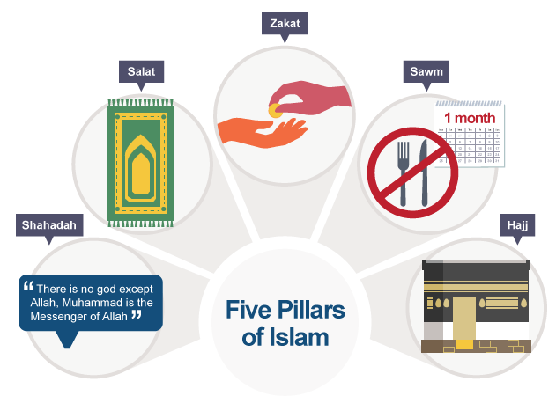
RE Focus | Islam: Commitment to God | Year 6 | Autumn 1
What? (Key Knowledge)
Al-Qadr | Islam teaches that Allah has full control over all that happens. Nothing can happen unless permitted by Allah. The Muslim word for this is predestination or Al-Qadr.
Insha'Allah | The phrase is commonly used by Muslims which means 'God wills it'. It demonstrates the Muslim belief that nothing happens unless Allah wills it to be so and that Allah's will is more important than anything else.
5 pillars of Islam | Muslims show their commitment to God in five clear ways. By committing a percentage of their earnings/wealth to charity. Zakah By praying 5 times a day to give thanks. Salah By attending Makkah (Mecca), at least once in your life, the place where Muhammad was born and where he first revealed the Qur'an. Hajj By fasting everyday during Ramadan. Sawm By pronouncing their faith: "I bear witness that there is no God except for Allah, and Muhammad (pbuh) is the messenger of God." Shahadah
Attainment Targets
To understand how Muslims show commitment to God To understand why different individuals demonstrate variable levels of commitment to their religion.
Key Questions
How committed are you to certain things that you have belief in? Is one pillar of Islam more important than an other?
What? (Key vocab)
Spelling | Definition
Zakah | Welfare or charity
Salah | Daily prayer
Hajj | Pilgrimage
Sawm | Fasting
Shahadah | Declaration of faith
Makkah | Holiest site in Islam
Ramadan | Muslim holy month
Possible experiences
To debate which could be the ‘most important’ pillar of Islam, with a guest Iman or Muslim parent as an adjudicator. To visit https://al-emaan.org.uk/#contact Al-Emaan mosque in Keston.

