Slide 1

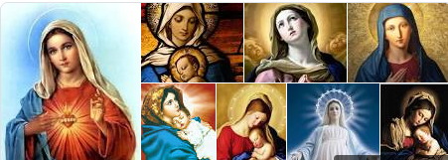
St Mary Cray Primary – Knowledge Organiser
RE Focus | Christianity: Mary, mother of Jesus | Year 6 | Autumn 2
What? (Key Knowledge)
Jesus Christ: | Main Christian belief that Jesus was born as son of God, but to the virgin Mary.
Why Mary was chosen: | She was the ‘lord`s servant’, humble and ordinary – this symbolised Jesus being pure and ‘for everyone’. (Luke 1: 26-38) (Luke 1: 47 -58)
Why it was important that she was a virgin: | Her being a virgin indicated that Jesus was not merely human, but also God. (John 1:14)
Joseph`s reaction: | Joseph originally wanted to call off the engagement as he felt that Mary had betrayed him - until the Angel Gabriel visited him. (Matthew 1: 18-25)
Attainment Targets
I can make links between the virgin birth and Christian beliefs about incarnation. I can explain my own response as to why Mary was chosen as Jesus` mother.
Key Questions
Why was Jesus sent to Earth in this way rather than another? Why was Mary chosen above all others? Whilst respecting Christian`s views; how do I feel about the suggestion in the bible that Mary was a virgin?
What? (Key vocab)
Spelling | Definition
incarnation | Incarnation, central Christian doctrine that God became flesh, that God assumed a human nature and became a man in the form of Jesus Christ, the Son of God.
resurrection | Resurrection, the rising from the dead of a divine or human being who still retains his own personhood, or individuality, though the body may or may not be changed.
virgin | A person who has never had sexual intercourse.
conceived | To become pregnant with a child.
Mary is generally portrayed in art as innocent and pure; and she is known by many different titles (Blessed Mother, Maria, Madonna, Our Lady).
Possible experiences
Make a spider diagram to explain what attributes someone may have if they are chosen for something important. Visit local church and ask for bible passage references from the Priest to explain key concepts.

