Slide 1

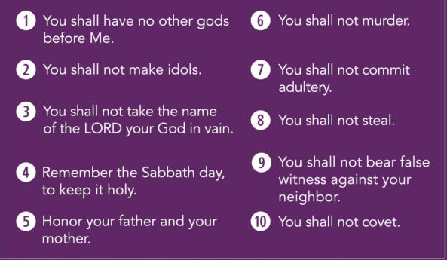
St Mary Cray Primary – Knowledge Organiser
RE Focus | Christianity: eternal life | Year 6 | Spring 1
What? (Key Knowledge)
Resurrection and ‘day of judgement’. | The resurrection of Jesus is the Christian belief that God raised Jesus after his crucifixion as first of the dead, starting his exalted life as Christ and Lord until his ‘second coming’. His resurrection is the guarantee that all Christians will also obtain eternal life.
10 commandments and Heaven and hell. | Christians believe that if they adhere to the 10 commandments (as recorded in Exodus 20 and Deuteronomy 5 and shown in purple below), and repent their sins, then they will be granted eternal life in heaven.
Attainment Targets
To understand the Christian perspective on ‘eternal’. To understand that Jesus felt that love was unconditional and forever. To understand that, as a result of Jesus` resurrection, Christians believe that they may be granted eternal life in heaven is they are a good Christian.
Key Questions
Does anything last forever - life, love, relationships ? Is going to heaven a Christian`s only incentive for living a good life?
What? (Key vocab)
Spelling | Definition
humanist | Humanists believe that human experience and rational thinking provide the only source of both knowledge and a moral code to live by. They reject the idea of knowledge 'revealed' to human beings by gods, or in special books.
agape | is a Greco-Christian term referring to love, "the highest form of love, charity" and "the love of God for man and of man for God"
resurrection | Resurrection, the rising from the dead of a divine or human being who still retains his own personhood, or individuality, though the body may or may not be changed.
eternal | lasting or existing forever; without end
Possible experiences
Make a class collage of what the world would look like if we all ‘loved our neighbour’. Teach p4c session on the concept of ‘forever’. Study key bible passages from jigsaw planning, including Jesus forgiving his crucifiers, to illustrate the concepts of the 10 commandments, eternal life and love being never-ending.

