Slide 1
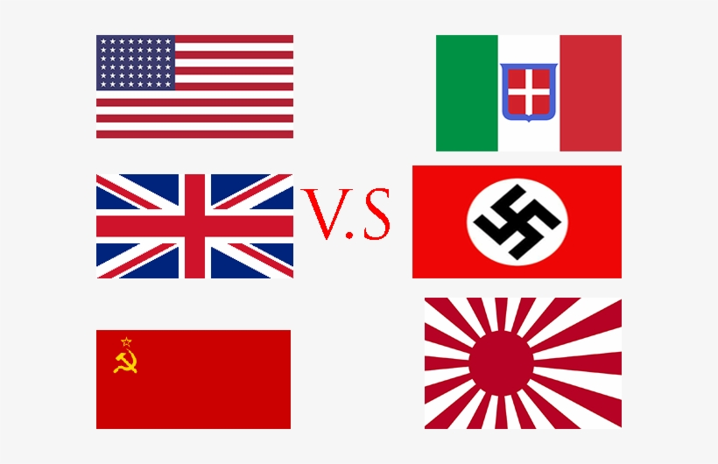
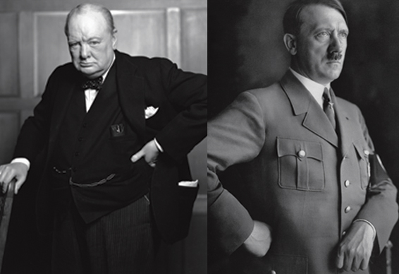
History Focus | WW2 | Year 6 | Spring
When? (Key Knowledge)
September 1938 | Munich Agreement – Nazi Germany allocated portion of Czechoslovakia
1st September 1939 | Germany invades Poland
3rd September 1939 | Great Britain, France and the Allied Forces declare war on Germany.
April – June 1940 | Germany invades various European countries (10th May, Churchill elected Prime Minister)
10th July – 31st Oct 1940 | Battle of Britain The Blitz begins
7th December 1940 | Japan bombs Pearl Harbour USA declares war on Japan, Germany and Italy
6th June 1944 | D Day landings – British, Canadian and US troops land in Normandy
8th May 1945 | VE Day – Britain celebrates victory in Europe.
Background Information
World War 2 was a battle between two groups of countries, the Allied Forces and the Axis Powers. Together with the Nazi Party, Hitler wanted Germany to rule Europe. On 1st September 1939, German troops invaded Poland. Hitler refused to stop the invasion, therefore Britain and France declared war and WW2 began. The USA did not join the war until 1941, when Japan attacked the naval base at Pearl Harbour (Hawaii).
What? (Key vocab)
Spelling | Definition
Allied Forces | An alliance between a number of countries including Britain, France, Russia, China, and USA.
Axis Power | Germany, Italy and Japan.
Holocaust | Persecution and murder of 6, million Jews by the Nazi regime
Blitz | Relentless bombing of Britain by the Germans. It lasted for 57 consecutive nights.
Propaganda | Information used and distributed to present one side of an issue. Both Allied and Axis powers used propaganda to boost the moral of people at home and those fighting.
Rationing | The limitation of food and other supplies during and after the war
Invasion | Forcefully taking over another country
Evacuee | A child or vulnerable person sent to live in the countryside for safety
Key Figures
Neville Chamberlain Winston Churchill Adolf Hitler Charles DeGualle Franklin D Rooselvelt Benito Mussolini Josef Stalin | British Prime Minister 1937 – 1940 1940 – 1945 Chancellor of Germany 1933 – 1945 French Prime Minister President of the USA 1933- 1945 Italian Prime Minister 1922- 1943 Lead the Soviet Union mid 1920 - 1953
Churchill
Hitler

