Slide 1
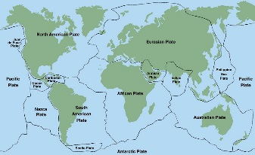
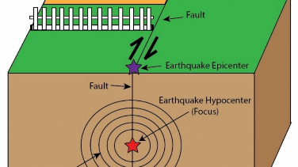
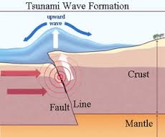
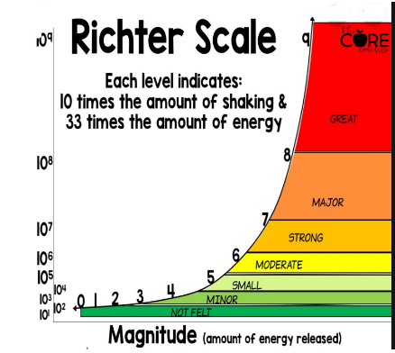
Geography Focus | Natural Disasters | Year 6 | Spring
What? (Key Knowledge)
What causes them? | Earthquakes are caused by the movement of tectonic plates along either normal, reverse or strike-slip faults. Due to the pressure, movement is not continues but in short sharp bursts (earthquakes). This is stick slip motion. They can vary in magnitude, and are measured on the Richter scale. They can occur close to the surface, or deep in the ground. An earthquakes with a shallower focus will generally be more violent as more energy is transmitted to the surface.
Primary effects | These are a direct consequence of the earthquake. The ground shaking, buildings collapsing, roads being destroyed.
Secondary effects | These are knock on effects. Fires, landslides, tsunamis, disease, infection, loss of education and business. Often the secondary effects cause more devastation. These can also be sorted into long and short term impacts.
Tsunami | A tsunami is caused by an earthquake in the ocean. The land moves causing large amounts of water to displace. This generates a large, fast moving wave.
Case study | Children should know the details of a recent earthquake.
What? (Key vocab)
Spelling | Definition
Tsunami | A large, fast moving sea wave, often caused by earthquakes
Earthquake | The movement of the ground as a result of tectonic activity
Epicentre | The location of the earthquake on the Earth’s surface
Focus | The location of the earthquake below the Earth’s surface
Tectonic Plates | Sections of the Earth’s crust which move slowly over the mantle
Crust | The hard rocky layer of the earth
Mantle | The hot viscous layer of the earth made up of melted rock
Primary effects | The direct impact of an event. Eg buildings collapsed
Secondary effects | The knock on effects of an event. Eg schools closed, tsunamis
Richter scale | The way in which the magnitude of earthquakes are measured
Fault line | Where two or more tectonic plates meet.
Diagrams and Symbols
Possible experiences
Complete an earthquake drill within their class. How could you better survive? Create earthquake proof structures. Test with shaking tables Look at a case study of an earthquake. Children to identify primary and secondary effects. Compare case studies of earthquakes in different countries (HIC vs LIC, high income county vs low income) Which was more damaging, why? To make a tsunami in the classroom.

