Slide 1
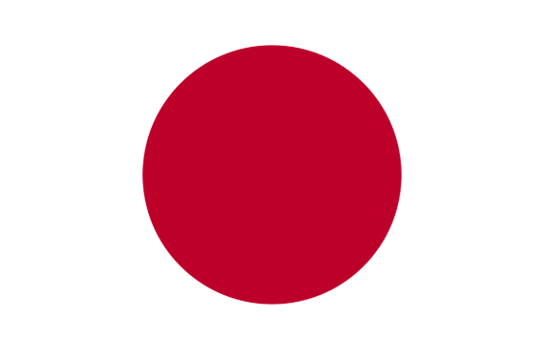
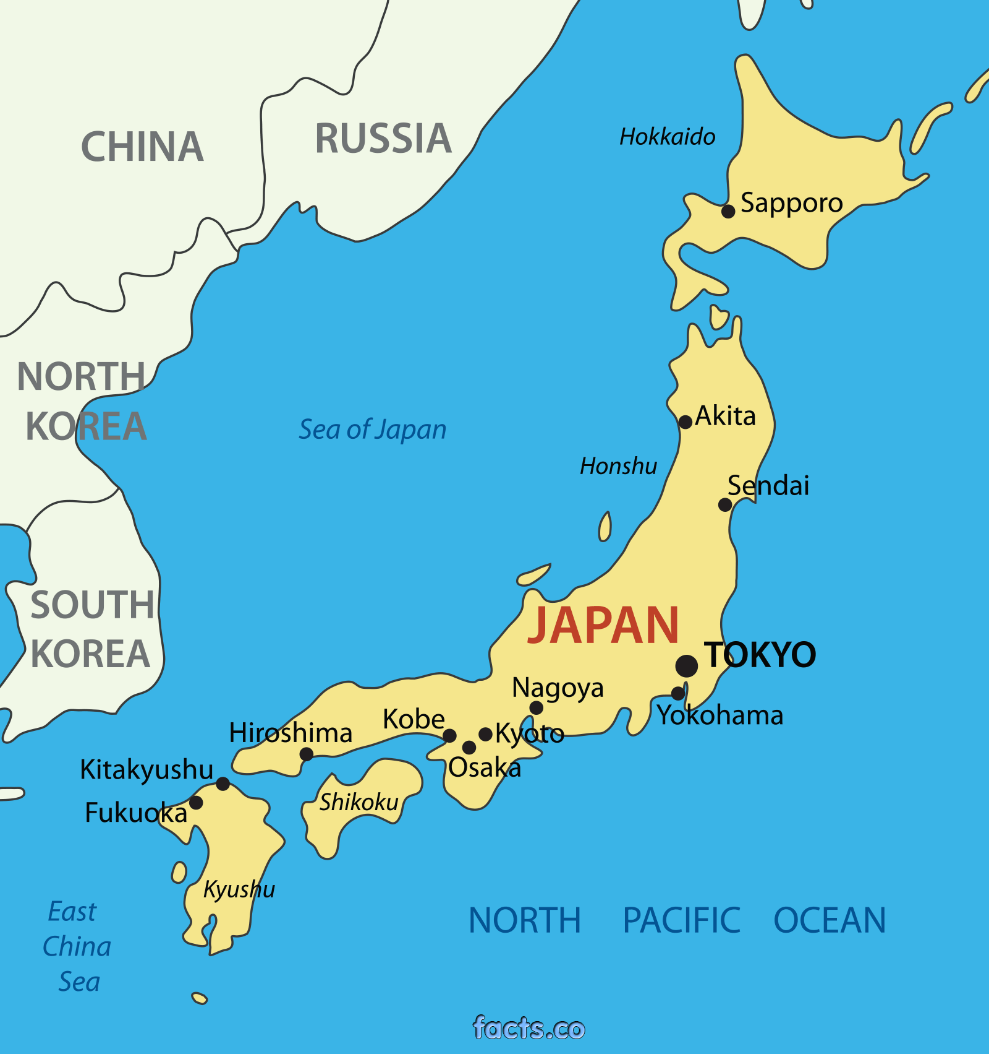
Geography Focus | Asia (Japan) | Year 6 | Autumn 1
What? (Key Knowledge)
Basic Facts | Continent: Asia (Japan is in East Asia) Capital: Tokyo Population: Over 126 million Currency: Yen Language: Japanese
Flag
Human Feature | Japan is a very urbanised country and are heavily invested in the development of technology
Physical Features | Japan sits on the subduction zone between two tectonic plates. As such, it is prone to experiencing earthquakes and tsunamis. It is a very mountainous country, made up of nearly 7000 islands; and 66% of the country is forest.
Climate | Japan experiences four distinct seasons with warm summers and cold winters. Climates vary between the East and West of the country.
Global Issues | Whaling - is it right or wrong? Nuclear power - useful or not?
What? (Key vocab)
Spelling | Definition
Tsunami | A giant sea wave caused by a large earthquake or disturbance.
Earthquake | The shifting of the Earth due to the movement of tectonic plates.
Tectonic plates | Parts of the lithosphere of the Earth which float on and travel independently over the mantle.
Whaling | The commercial hunting of whales.
Nuclear Power | Electrical energy generated through a nuclear reactor.
Kawaii | The ‘cute’ ‘lovable’ culture in Japan, which can relate to humans and non-humans.
Emperor | The head of state for the country: similar to our queen.
Possible experiences
Study national Japanese sports (judo/sumo) and have guest attend to model! Complete graph work comparing climates of UK and Japan. Linking to art, children to draw in a kawaii style. Complete earthquake drills in the classroom. Sample Japanese food (using chopsticks) and culture and study Japanese traditions and festivals – Hanami, Poshogatsu, and Chado/Chanoyu
Diagrams and Symbols

