Slide 1
WALT : explain how we can deal with illness

Slide 2
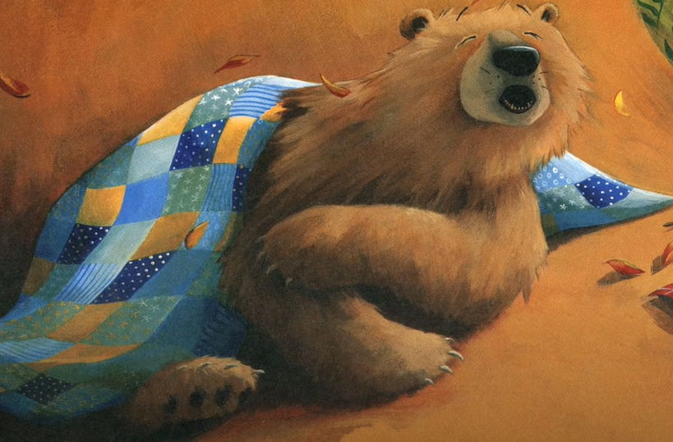
Bear feels sick by Karma Wilson https://www.youtube.com/watch?v=L26huJs7yq4
What happened to bear?
How did he feel better
Was it a miracle? What is a miracle?
How do our bodies get better when we are poorly?
What happens and how does it feel when we get poorly/sick?
If you are poorly what do you do? Who looks after you?
How do you get better? Do you go to the doctor/need medicine?
Sometimes we can help ourselves - how?

Slide 3
A remedy to make someone feel better.
Collect natural ingredients for a remedy to help someone feel better.
(Leaves, stones, pebbles, twigs, petals, grass, cones etc)
Next we will create a class recipe using our ingredients.

Slide 4
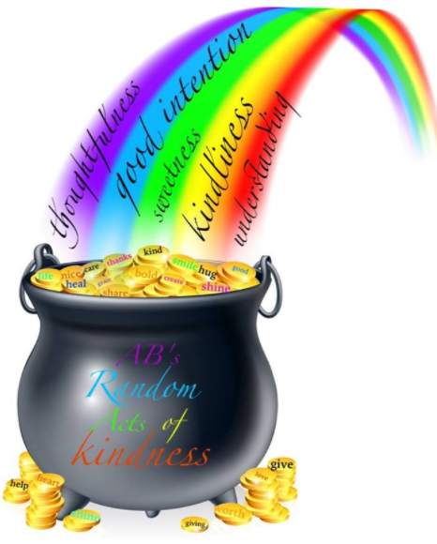
A recipe example
You will need:
10 golden Autumn leaves
4 yellow petals
3 blades of frost covered grass
2 round shiny pebbles
1 small stick
20 pine needles
1 pine cone
3 cups of kindness
A handful of love
One smile
What you need to do:
Mix all the ingredients together in a pan
Heat gently over a fire
Stir with the stick
Serve immediately
What do you think the most important ingredient in our recipe was? Why?

