Slide 1
English week 1: 4th January 2021 – 8th January 2021
Ug

Slide 2

Day 1: Monday 4th January
Task 1: WALT predict what is going to happen in the story by looking at the front cover.
Look at the front cover, answer the following either write them down or share your answers with an adult. You could send us a video on class dojo!
1. What is the first thing you notice about the illustration?
2. What clues are there to help you predict what the story will be about?
3. What questions do you have about the story?
4. Look at the background does this give us a clue to when this story is set?

Slide 3
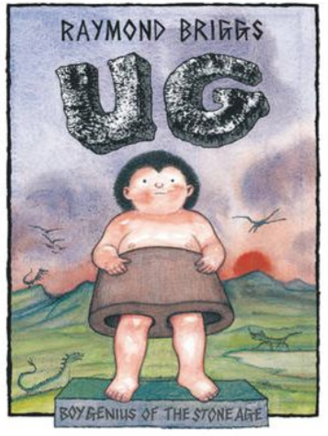
Day 2 Tuesday 5th January
Task 2: WALT find out about when the story was set.
The story of Ug was set in the Stone age.
Complete Task 2
You will need to use the websites below to help you answer questions about the stone age.
https://www.funkidslive.com/learn/top-10-facts/top-10-facts-about-the-stone-age/#
https://kids.kiddle.co/Stone_Age

Slide 4
Day 3:Wednesday 6th January 2021
WALT use inference to describe a character.
Task 3:
Watch the videos of Mr Kay reading Ug: Boy Genius of the Stone age. Parts 1-5
https://www.youtube.com/watch?v=_BjIO0lwrcY
Choose one of the main characters:
Ug (the boy)
Dug (the dad)
Dugs (the mum)
As you are watching note down their characteristics.
External characteristics: appearance, interests, clothing they are wearing, talents.
Internal characteristics: Personality, feelings, thoughts.
There maybe links between the two! What do facial expressions tell you about their personality?
Task: Draw an outline of the character – the size of half an A4 piece of paper. Write all the external characteristics on the outside and all the internal characteristics on the inside.

Slide 5
Day 4: Thursday 7th January 2021
Task 4: WALT use persuasive language effectively.
What could Ug do to convince his community to try cooked food?
Watch one of these videos to help
How could he persuade them?
Task 4: You are going to pretend to be Ug and you are going to write your own script for a cookery demonstration.
You could take a modern day food such as ham and pineapple pizza and give it a Stone age twist e.g. Mammoth and apple pizza.
What Stone age implements could you use to prepare the food?
Sharp stone instead of a sharp knife
Hot rock instead of a frying pan
https://www.youtube.com/watch?v=w6GuJhD1wFE
Munchbox clip
https://www.youtube.com/watch?v=f91Mxutc1UM
Matilda Ramsey making ice lollies

Slide 6
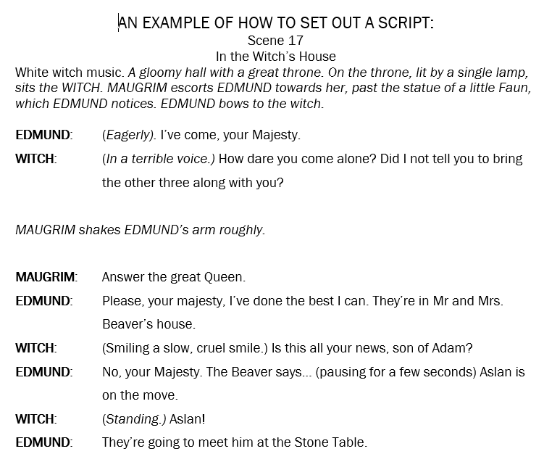
When you watched the videos:
Which words or phrases helped you to know what to do?
What was effective about the language used and style of delivery?
What kept you engaged? How did the presenter encourage you to try the recipe yourself?
An example of how to layout your script:

Slide 7
Day 5: Friday 8th January 2021
WALT edit and perform a script that uses persuasive language.
Task 5: Today I would like you to edit your script – ask a parent or older sibling to read it and ask them how it can be improved. Or you could send it to Mrs Fenton / Mrs Richards and we will give you some ideas.
Checklist
Have you used persuasive language? E.g. delicious, easy to make, tastes amazing, you’ll never go back to eating cold, chewy bits of animal again!
Have you included all the ingredients they will need to make the recipe?
Have you explained how to make the food, remember you want the Stone age colony to start eating cooked food – so it must be something you can cook on a fire.
REMEMBER – YOU ARE UG AND IT IS THE STONE AGE!

Slide 8
Friday 8th January 2021
Continued…
Now the fun bit!
Perform your script!
You might want to do this in the garden, you could use stones or rocks as utensils. You could build a pretend fire with twigs and sticks!
DO NOT USE ANYTHING SHARP OR MAKE A REAL FIRE.
Ask a parent or sibling to video your cookery demonstration and send them to us on class dojo – Mrs Fenton and I would love to see them! The best ones will receive a certificate when we get back to school!
Good luck

