Slide 1



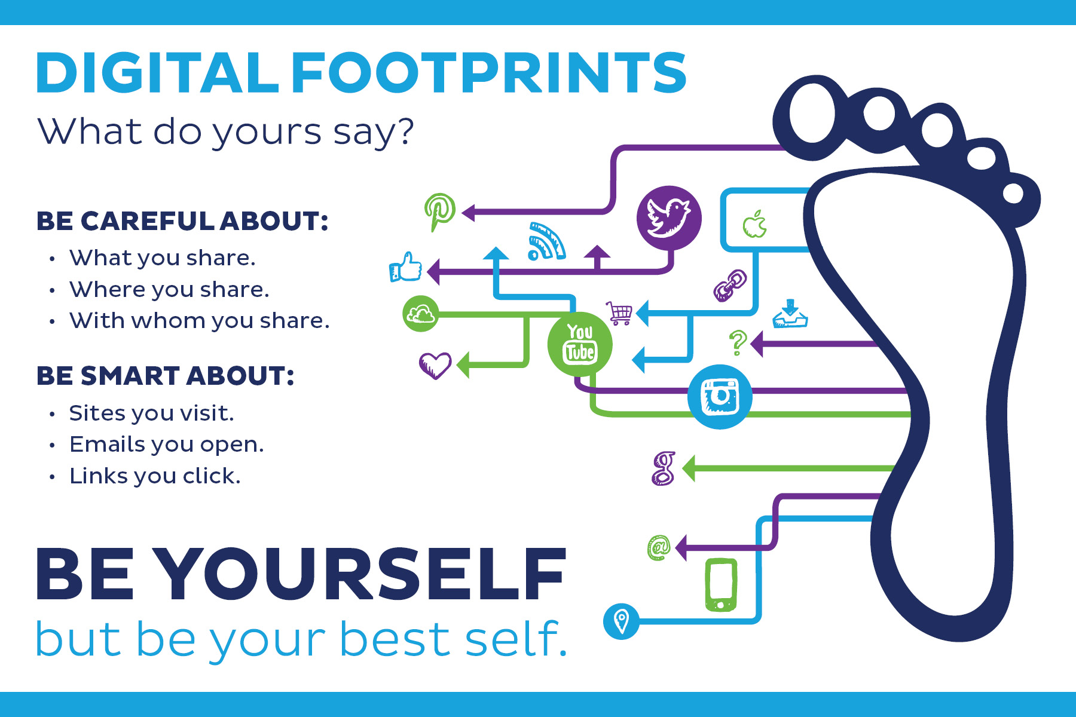

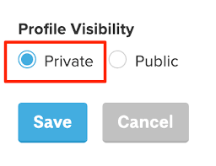
St Mary Cray Primary – Knowledge Organiser
Computing | E-safety - I am internet awesome | Year 3 | Autumn 1
What? (Key Knowledge)
Online privacy | A broad term that usually means the ability to control what information you share about yourself online and who can see and share it
Digital footprint (or digital presence) | Your digital footprint is all the information about you that appears online. This can mean anything from photos, audio, videos, and texts to “likes” and comments you post on friendsʼ profiles. Just as your footsteps leave prints on the ground while you walk, what you post online leaves a trail as well.
Reputation | The ideas, opinions, impressions, or beliefs that other people have about you; something that you can’t be totally sure about but that you usually want to be positive or good
Personal information: | Information that identifies a specific person – for example, your name, street address, phone number, Social Security number, email address, etc. – is called personal (or sensitive) info. Really think carefully before sharing this kind of information online.
Oversharing | Sharing too much online – usually this is about sharing too much personal information or just too much about yourself in a certain situation or conversation online.
Settings | This is the area in any digital product, app, website, etc., where you can define or adjust what you share and how your account is handled – including your privacy settings.
Possible experiences
develop understanding through group discussion
Attainment targets
use search technologies effectively, appreciate how results are selected and ranked, and be discerning in evaluating digital content select, use and combine a variety of software (including internet services) on a range of digital devices to design and create a range of programs, systems and content that accomplish given goals, including collecting, analysing, evaluating and presenting data and information use technology safely, respectfully and responsibly; recognise acceptable/unacceptable behaviour; identify a range of ways to report concerns about content and contact
Key Questions
Why does privacy matter How do we know what we (think we)know? What steps can you take if you accidentally share something personal?
What? (Key vocab)
Spelling | Definition
share | To share is to allow someone else to use something
profile | Profile is to create an overview about a person or thing
private | Private is something that is kept from sharing with others
respect | To show consideration for; avoid intruding upon or interfering with: to respect others' privacy

Slide 2




St Mary Cray Primary – Knowledge Organiser
Computing | Digital Literacy: using a computer | Year 3 | Autumn 2
What? (Key Knowledge)
community | People who share a common neighborhood, background, or interests
Internet | A worldwide network that connects people using computers, phones, or other devices
advertise | To draw attention to something that is for sale, and try to get people to buy it
header | Information at the top of a message that contains the sender’s address and the date
Possible experiences
Group discussion Peer to peer collaborative working
Attainment targets
use search technologies effectively, appreciate how results are selected and ranked, and be discerning in evaluating digital content use technology safely, respectfully and responsibly; recognise acceptable/unacceptable behaviour; identify a range of ways to report concerns about content and contact
Key Questions
What is the difference between your in-person community and your online community? How do you think games might help sell the products online?
What? (Key vocab)
Spelling | Definition
Secure | To keep something safe and protected
Password | a secret word or phrase that some websites require you to type in if you want to visit them
Protect | To keep safe
Online | Connected to the Internet

Slide 3


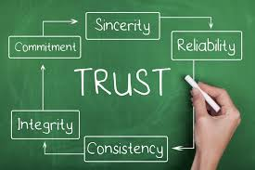

St Mary Cray Primary – Knowledge Organiser
Computing | Digital Literacy:Explore a Topic with Research and Collaboration | Year 3 | Spring 1
What? (Key Knowledge)
Search engine | a program that searches for and identifies items in a database that correspond to keywords or characters specified by the user, used especially for finding particular sites on the World Wide Web.
Advance internet search | Advanced search is a built-in feature of most search engines that allows a user to specify additional requirements for a search.
Filter | Search filtering allows you to limit the results to a reduced set that matches the filter(s) you select
Plagiarism | Using someone else’s thoughts or words as your own.
Possible experiences
Children research a topic they are learning or their Year group Children produce a document with multiple paragraphs about what they have found Children develop typing formatting and editing skills on computer
Attainment targets
understand computer networks, including the internet; how they can provide multiple services, such as the World Wide Web, and the opportunities they offer for communication and collaboration use search technologies effectively, appreciate how results are selected and ranked, and be discerning in evaluating digital content select, use and combine a variety of software (including internet services) on a range of digital devices to design and create a range of programs, systems and content that accomplish given goals, including collecting, analysing, evaluating and presenting data and information use technology safely, respectfully and responsibly; recognise acceptable/unacceptable behaviour; identify a range of ways to report concerns about content and contact
Key Questions
How do you search for an exact phrase
What? (Key vocab)
Spelling | Definition
research | The collecting of information about a particular subject
credibility | the fact that someone or something can be believed or trusted:
paragraph | A paragraph is a series of related sentences developing a central idea
Tab | A second or further document or page that can be opened on a spreadsheet or web browser.

Slide 4
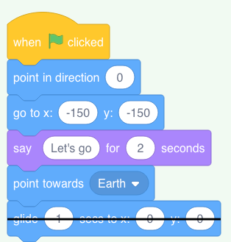


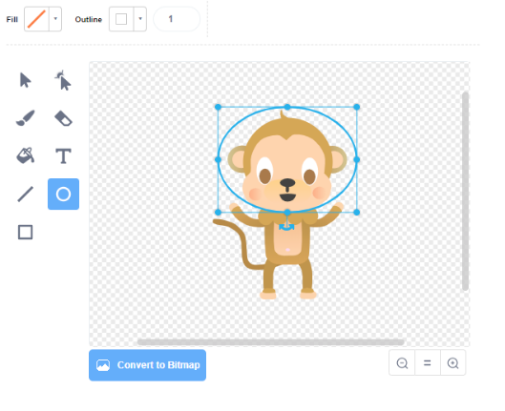
St Mary Cray Primary – Knowledge Organiser
Computing | Coding: Animations - Space | Year 3 | Spring 2
What? (Key Knowledge)
Animation | Animation is a method in which pictures are manipulated to appear as moving images.
Coordinates | Scratch's coordinate system uses 2 coordinates, "X position" and "Y position", to determine the location of a sprite on the stage.
Costumes | A costume is one out of possibly many "frames" or alternate appearances of a sprite.
Stage | The stage is the background of the project, but can have scripts, backdrops (costumes), and sounds, similar to a sprite.
Possible experiences
Design and make own individual animation Experiment creating sequences
Attainment targets
design, write and debug programs that accomplish specific goals, including controlling or simulating physical systems; solve problems by decomposing them into smaller parts use sequence, selection, and repetition in programs; work with variables and various forms of input and output use logical reasoning to explain how some simple algorithms work and to detect and correct errors in algorithms and programs
Key Questions
Do I know how to use a repeat loop to animate a sprite in Scratch? Do I know how to Use a forever loop to repeat an animation indefinitely? Do I understand that loops can be nested within each other?
What? (Key vocab)
Spelling | Definition
Sprite | A sprite is a bitmap graphic that is designed to be part of a larger scene. It can either be a static image or an animated graphic.
Block | A block is a section of software code or an algorithm in software programming. A block can consist of one or more statements or declarations.
Program | To create a sequence with objects in scratch for a specific aim.
repeat | To redo an action

Slide 5
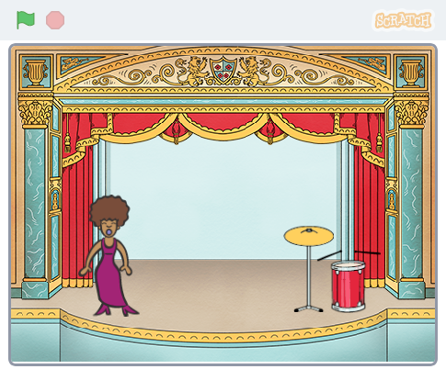
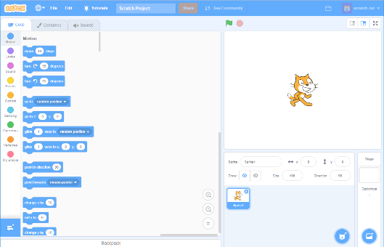
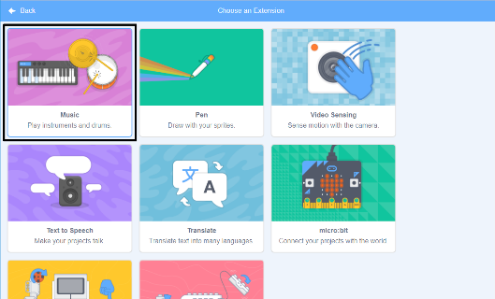
St Mary Cray Primary – Knowledge Organiser
Computing | Coding: Sound and music - Rock band | Year 3 | Summer 1
What? (Key Knowledge)
Animation | Animation is a method in which pictures are manipulated to appear as moving images.
Coordinates | Scratch's coordinate system uses 2 coordinates, "X position" and "Y position", to determine the location of a sprite on the stage.
Costumes | A costume is one out of possibly many "frames" or alternate appearances of a sprite.
Stage | The stage is the background of the project, but can have scripts, backdrops (costumes), and sounds, similar to a sprite.
Possible experiences
Design and make own individual animation Experiment creating sequences
Attainment targets
design, write and debug programs that accomplish specific goals, including controlling or simulating physical systems; solve problems by decomposing them into smaller parts use sequence, selection, and repetition in programs; work with variables and various forms of input and output use logical reasoning to explain how some simple algorithms work and to detect and correct errors in algorithms and programs
Key Questions
Use code to change a sprite’s costume in Scratch Use code to make sprites react to input in Scratch Add sounds to a sprite in Scratch
What? (Key vocab)
Spelling | Definition
Sprite | A sprite is a bitmap graphic that is designed to be part of a larger scene. It can either be a static image or an animated graphic.
Block | A block is a section of software code or an algorithm in software programming. A block can consist of one or more statements or declarations.
Program | To create a sequence with objects in scratch for a specific aim.
repeat | To redo an action

Slide 6
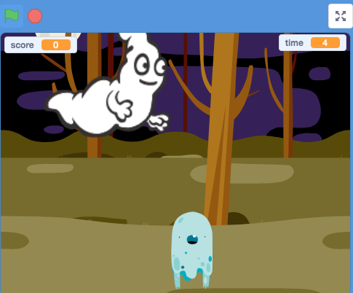
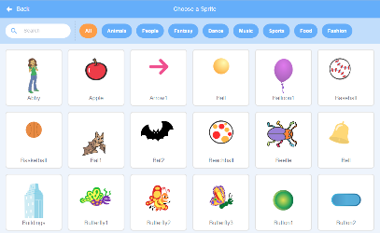
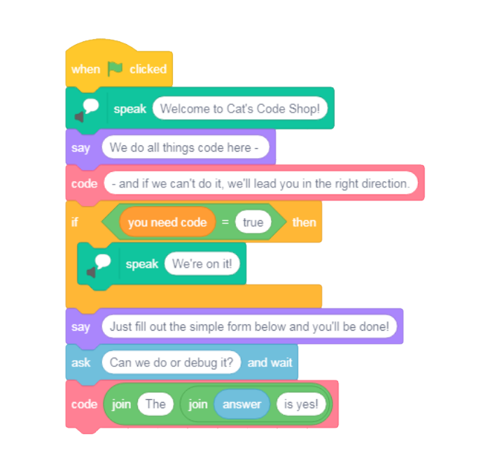
St Mary Cray Primary – Knowledge Organiser
Computing | Coding: Scratch Project | Year 3 | Summer 2
What? (Key Knowledge)c
Animation | Animation is a method in which pictures are manipulated to appear as moving images.
Coordinates | Scratch's coordinate system uses 2 coordinates, "X position" and "Y position", to determine the location of a sprite on the stage.
Costumes | A costume is one out of possibly many "frames" or alternate appearances of a sprite.
Stage | The stage is the background of the project, but can have scripts, backdrops (costumes), and sounds, similar to a sprite.
Possible experiences
Design and make own individual animation Experiment creating sequences
Attainment targets
design, write and debug programs that accomplish specific goals, including controlling or simulating physical systems; solve problems by decomposing them into smaller parts use sequence, selection, and repetition in programs; work with variables and various forms of input and output use logical reasoning to explain how some simple algorithms work and to detect and correct errors in algorithms and programs
Key Questions
Do you understand the need for pauses between actions within loops Do you know how to use code to generate random numbers in Scratch Do you know how to add a variable to store a game score in Scratch
What? (Key vocab)
Spelling | Definition
Sprite | A sprite is a bitmap graphic that is designed to be part of a larger scene. It can either be a static image or an animated graphic.
Block | A block is a section of software code or an algorithm in software programming. A block can consist of one or more statements or declarations.
Program | To create a sequence with objects in scratch for a specific aim.
repeat | To redo an action

