Slide 1
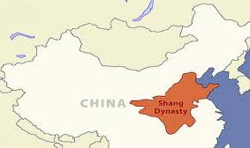
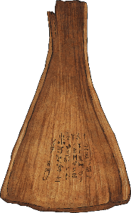
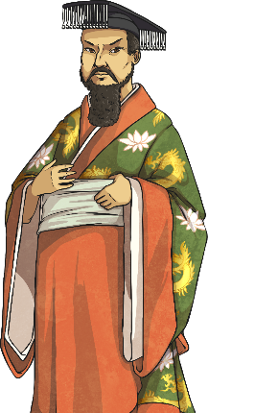
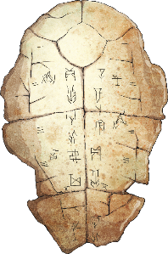
History Focus | Shang Dynasty | Year 3
Midfield Primary School – Knowledge Organiser
When? (Key Knowledge)
1600 BC | Cheng Tang founds the Shang dynasty after overthrowing the legendary Xia dynasty
1400 - 1200 BC | The earliest found examples of Chinese writing are dated to around this time
1250 BC | King Wu Ding begins his reign
1200 BC | Fu Hao, wife of King Wu Ding, dies
1075 BC | The last Shang king, Di Xin, begins his reign
1046 BC | The slaves revolt in protest of cruel treatment and increasing taxes. The Shang dynasty is overthrown and the Zhou dynasty begins
Background Information
The Shang Dynasty (ruled by the Shang family) was located in ancient China. The civilisation lasted from around 1600 BC until 1046 BC. It was the second dynasty of China which succeeded the Xia Dynasty (c. 2700-1600 BCE) after the overthrow of the Xia tyrant Jie by the Shang leader, Tang. We know lots about the Shang dynasty from archaeological remains and written documents.
What? (Key vocab)
Spelling | Definition
Dynasty | A sequence of rulers from the same family
Emperor | The ruler of a country
Artefacts | Objects found from previous civilisations
Merchant | A person who trades or sells items as a living
Civilisation | The culture of people living together
Oracle bones | Bones which were used to conduct a divination ceremony and speak to ancestors
Social Hierarchy | The different groups of people and their lifestyles
Peasant Farmer | One of the lowest social classes, the peasant farmers spent all days in the fields growing and harvesting crops
Diagrams
Who?
Fu Hao | A great military leader and warrior. Her tomb is the only one to be left untouched
Tang | The first emperor of Shang. He was very popular and very successful
Shang Di | Believed to be the God with the ultimate spiritual power

