Slide 1
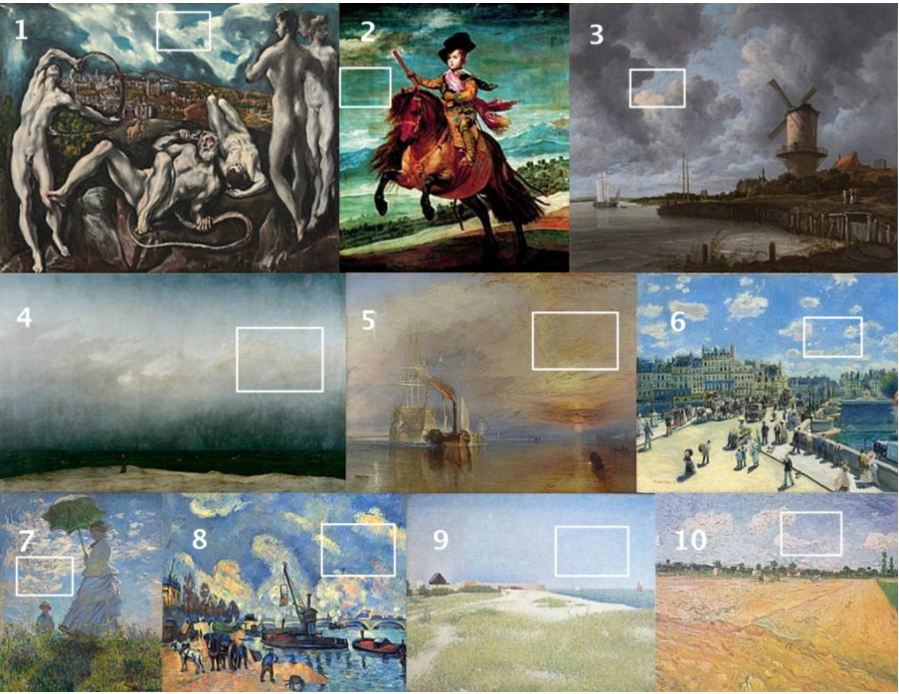
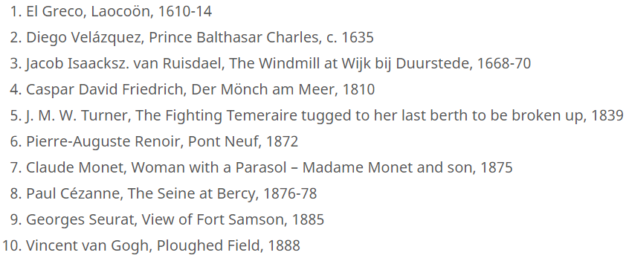
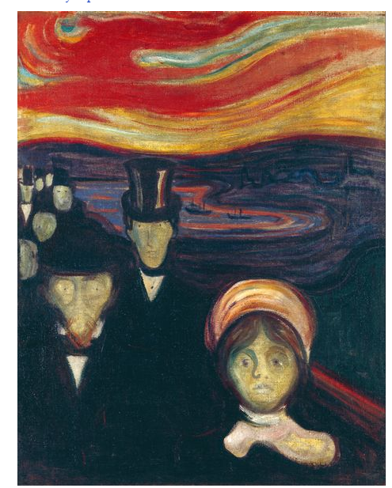
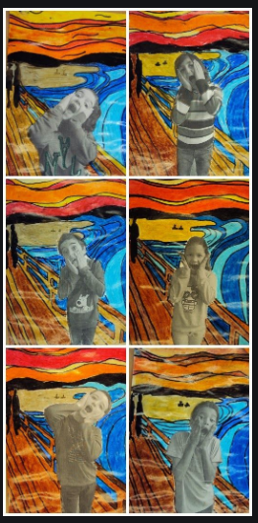
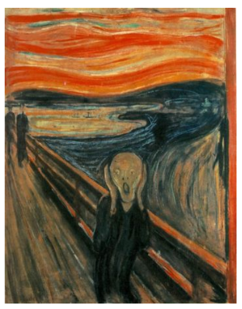
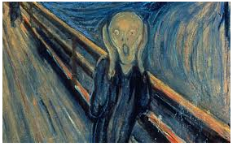
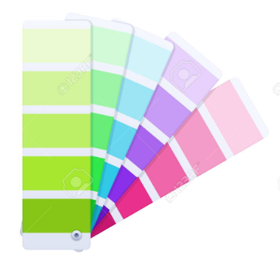
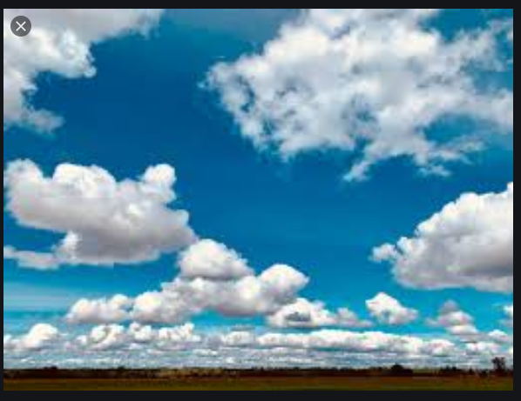
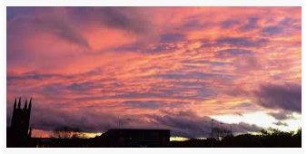
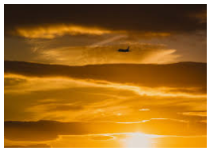
Spring Partnership Trust – Knowledge Organiser
Art Focus | Colour mixing | Year 3 | Autumn 2
Who? Famous Artists
Paintings of skies by famous artists
Edvard Munch | Edvard Munch was born in Norway in 1863. He was a painter and print-maker. He greatly influenced the development of the artistic style known as German expressionism. In that style, the artist seeks to portray emotions and responses to the world, rather than realistic depictions of its objects and events. His work often included the portrayal of such themes as misery, sickness, and death. The Scream, or The Cry (1893), was probably his most familiar painting. Munch’s parents, a brother, and a sister died while he was still young, which probably contributed to the bleakness of much of his work.
What? Key Skills
To demonstrate control in the application of tools and techniques. To use different shades, tools and techniques to express mood and for different purposes. To use techniques, colours, tools and effects to represent things seen, remembered or imagined.
What? Key vocab
medium | a way or method of communicating or expressing, such as painting, music, or language.
technique | the particular method or way of doing or performing something.
Expressionism | A movement that occurred in the early 1900s. Expressionist art tried to convey emotion and meaning rather than reality.
Emotion | a strong feeling such as joy, hatred, sorrow, or fear.
Mood | The way a person feels at a certain time
symbolism | is when one object or thing stands in the place of something else, such as an idea, another object, a person, or a place.
Pictures and diagrams
.

