Slide 1
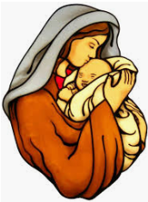
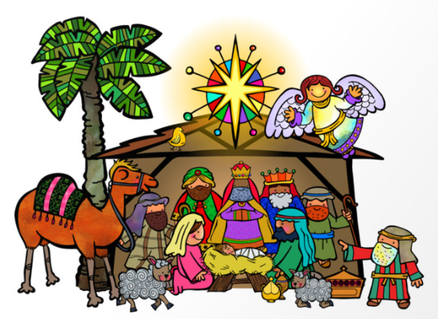

Midfield Primary School – Knowledge Organiser
R.E. Focus | Christianity: Christmas | Year 3 | Autumn 2
What? (Key Knowledge)
Why was Jesus sent to earth? | God sent Jesus to the earth to save/rescue people from their ‘sin’ and show them how to gain salvation.
Non-Christian aspects of Christmas | Less meaningful Christian celebrations might include a gift to friends, Christmas trees, meals, Christmas crackers and Father Christmas.
Christian aspects of Christmas | Meaningful Christian celebrations might include a birthday card for Jesus, a thank you gift to Jesus for saving/helping the world, services in a church, a star, gold, frankincense or advent wreath.
Incarnation | Christians believe that Jesus is the incarnation of God on earth. For Christians, Incarnation means that Jesus is God in the flesh, and that, in Jesus, God came to live among humans.
Attainment Targets
I can explain what Christmas means to me and talk about whether this involves giving and receiving gifts. I can start to explain the Christian belief that Jesus was God in human form and why God gave him to the world. I can start to tell you what Christmas means to Christians and what it means to me.
Key Questions
Has Christmas lost its true meaning? What does Christmas MEAN to us? Why is Christmas MEANINGFUL to me or not? What is the true meaning of Christmas for Christians? If you could give the world one gift at Christmas to make it a better place, what would it be? What does having ‘meaning’ mean?
What? (Key vocab)
Spelling | Definition
Nativity | The story of the birth of Jesus Christ.
Salvation | Promise of life after death.
Incarnation | In the form of.
Saviour | A person who saves someone or something.
Advent | The lead up to Christmas (The arrival of something or someone important.)
Possible experiences
Visit to a local church during the lead up to Christmas – view the nativity scenes. Outdoor Learning – Use natural materials to represent meaningful aspects of Christmas.

