Slide 1
L.O. I know how to explain erosion
Geography

Slide 2
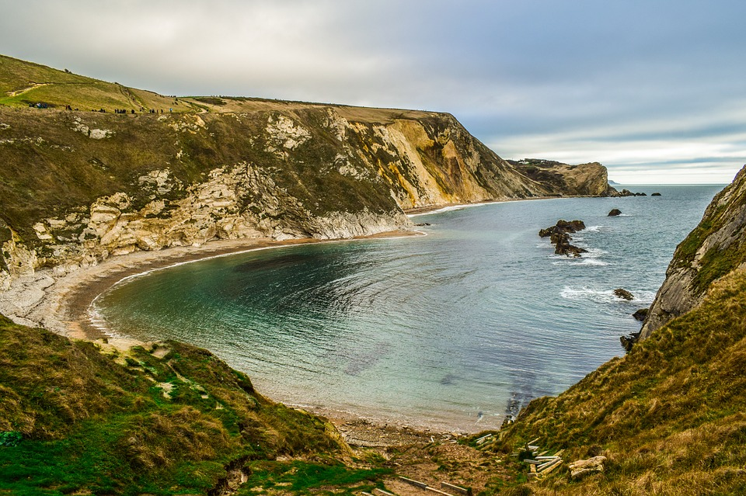
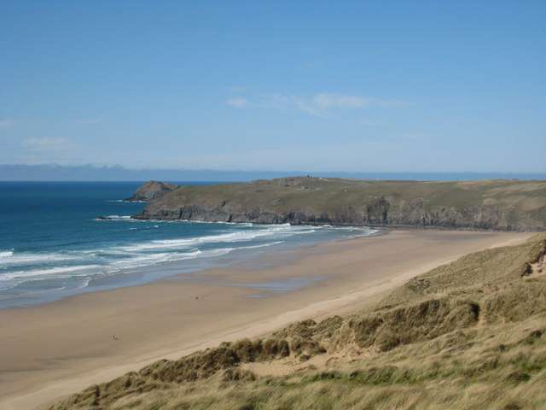
What is the coast?
The coast is where the land meets the sea.

Slide 3
What physical features can you see on the coast?

Slide 4
What physical features can you see on the coast?
beaches
cliffs
sand
pebbles
rocks
caves
rock pools
arch
stack

Slide 5
Whys does the coast look different everywhere?
The sea constantly bashes against the edge of the land in different directions.
Some rock in the land is soft, some is hard.
Some places have more strong and forceful storms than others.

Slide 6

What is change?
Change is when something becomes different to how it was before.
E.g. it may be bigger or smaller in size etc.

Slide 7
Coastal Changes
Today we are learning about how the coast changes over time.
Why does this happen?

Slide 8
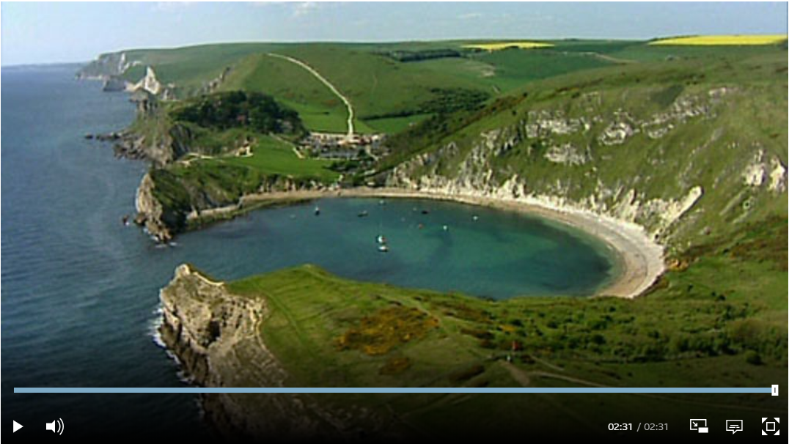
Watch up to 40 seconds only now.

Slide 9
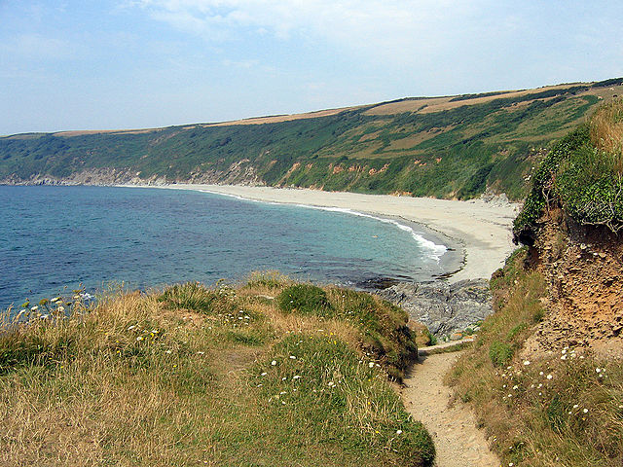
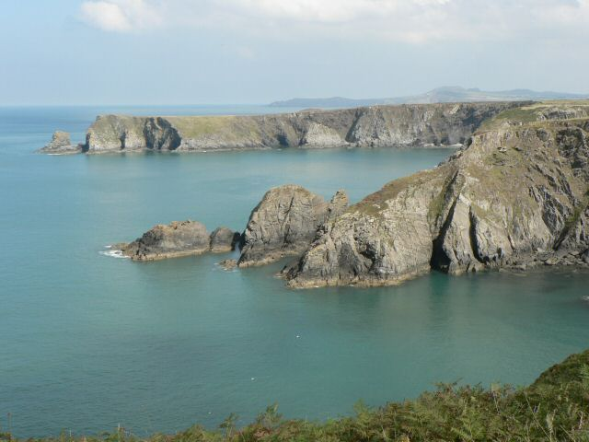
How are bays and headlands formed?
bay
headland

Slide 10
Inside the coast
The coasts are made of soft or hard rock. Often it can be in big patches likes this:
hard
rock
hard rock
Soft rock
hard rock
Soft rock

Slide 11
Inside the coast
Over time the sea can erode away the soft rock parts of the coast.
Soft rock
Soft rock
hard
rock
hard rock
hard rock

Slide 12
Inside the coast
In the gaps sand and rocks can collect and form sandy or pebbly bays.
Soft rock
Soft rock
hard
rock
hard rock
hard rock

Slide 13
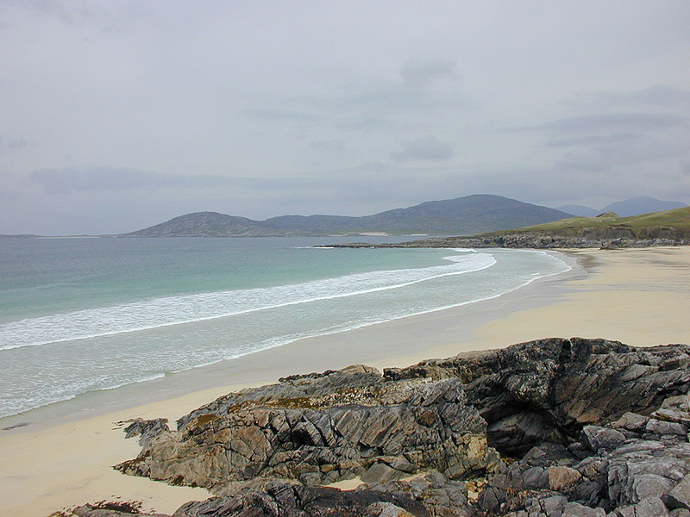
These lovely sandy bays are formed as the weaker section of coastline here have been eroded. The headlands stick out as they are harder more resistant rock which aren’t as easily eroded.
Softer, less resistant rock has already been eroded. Sediment has formed beaches.
Harder, more resistant rock

Slide 14
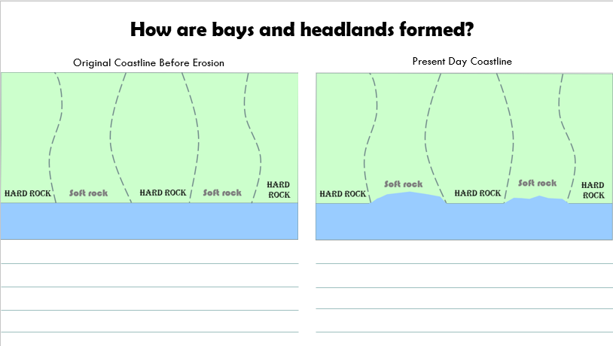
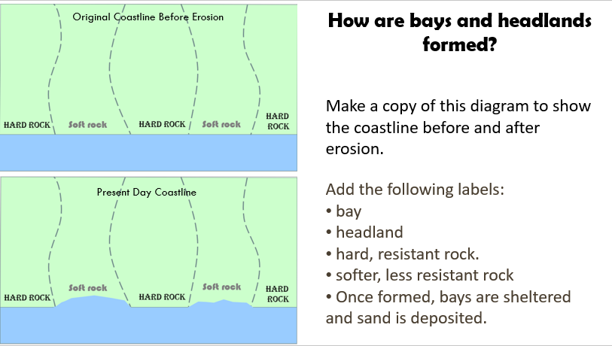
Activity 1
Choose either of the following slides for activity 1.
Explain the process of erosion which creates bays and headlands under the diagrams.
Follow the instructions, draw and label your own diagram.

Slide 15
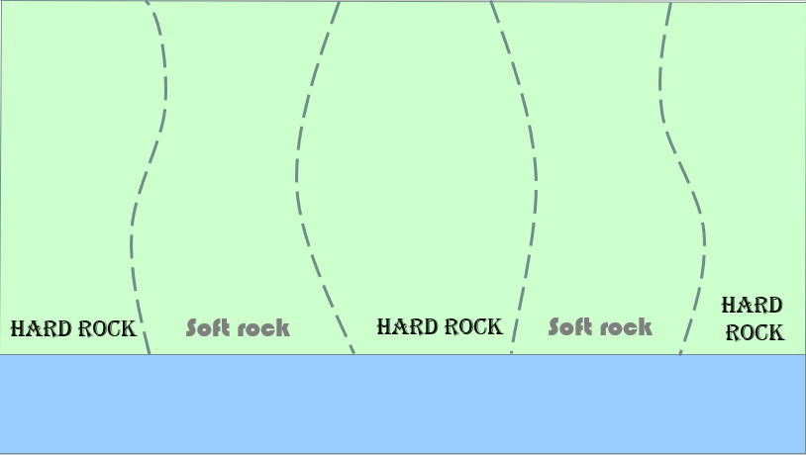
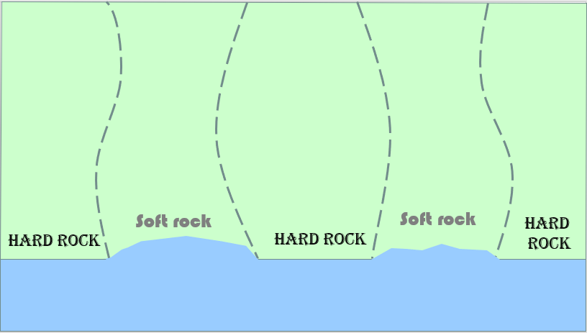
How are bays and headlands formed?
Original Coastline Before Erosion
Present Day Coastline

Slide 16
Original Coastline Before Erosion
How are bays and headlands formed?
Make a copy of this diagram to show the coastline before and after erosion.
Present Day Coastline
Add the following labels:
bay
headland
hard, resistant rock.
softer, less resistant rock
Once formed, bays are sheltered and sand is deposited.

Slide 17
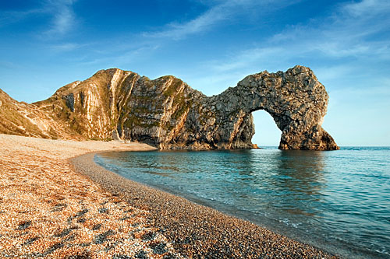
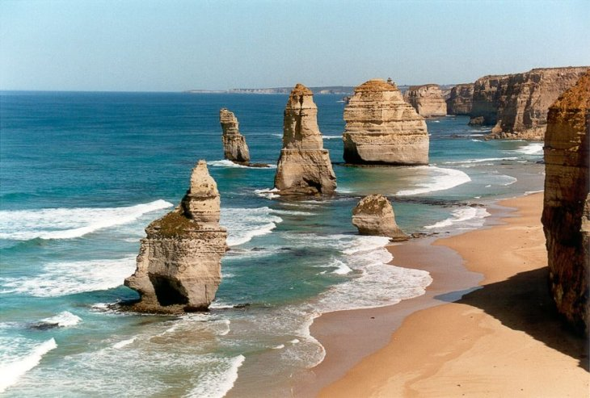
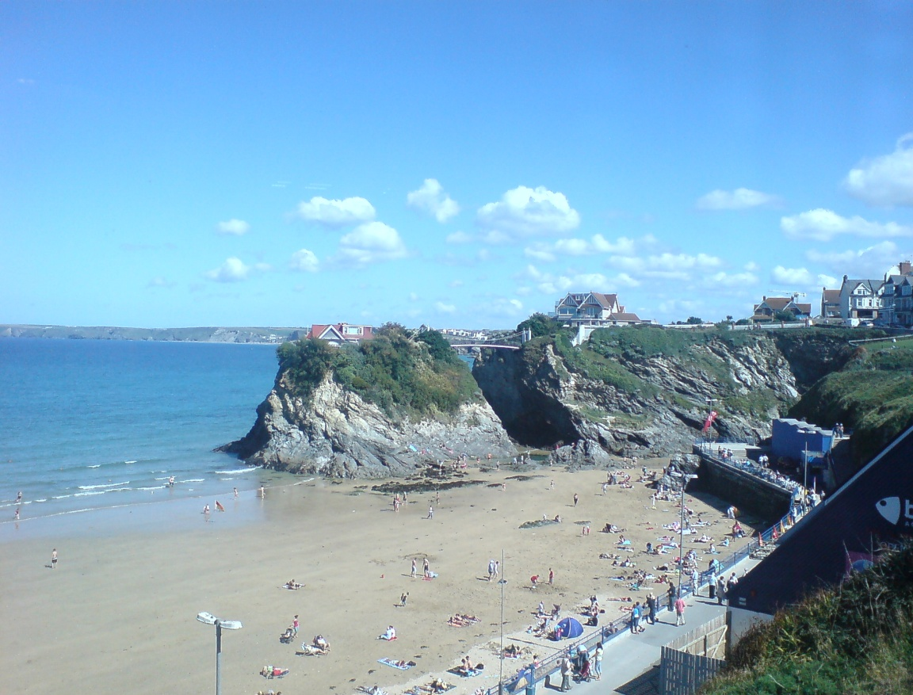
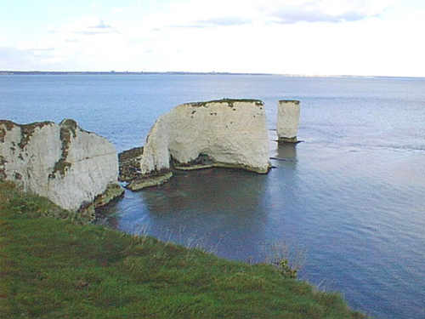
How are caves, arches, stacks and stumps formed?

Slide 18
Continue watching from 0:40 until the end of the clip.

Slide 19
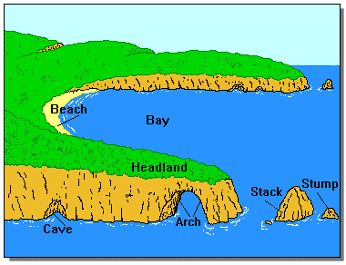

Slide 20
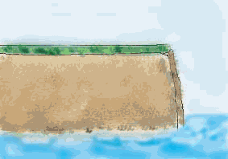

Slide 21
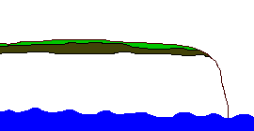

Slide 22
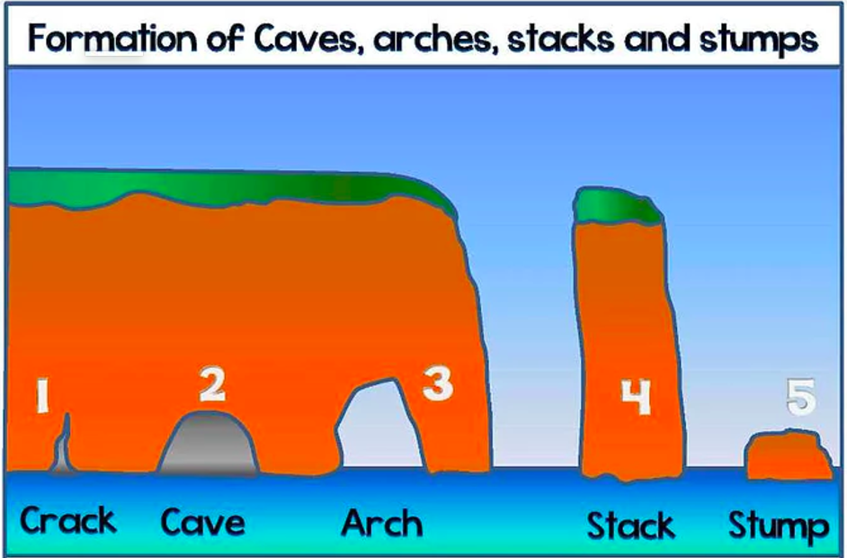

Slide 23
Waves attack a rock face using the force of the water and a crack forms in the weakest part of the rock.
Over time the crack enlarges to form a cave.
The cave is widened and deepened and pushes through the headland to form a natural arch.
More erosion from the sea and weathering can cause the arch to collapse, leaving a stack.
Over time further weathering and erosion lead the stack to wear down to a stump.

Slide 24
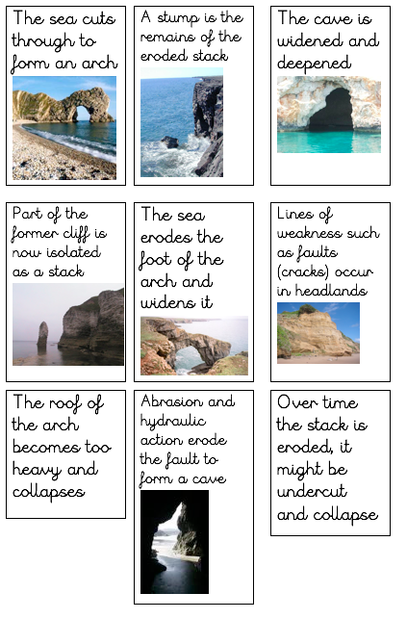
Order these images on your table to show how an arch and stack is formed.

Slide 25
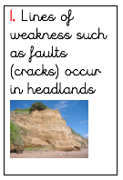
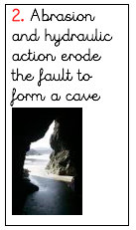
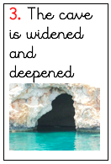
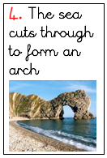
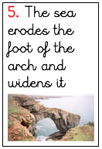
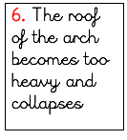
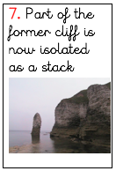
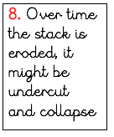
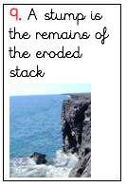

Slide 26
Activity 2
Stick in the diagram of coastal erosion examples. Label each word with the correct number.
Challenge
Explain how each feature above is formed.
Chilli-Hot Challenge
Look at the information on wave cut platforms. Explain how you think they are formed.

Slide 27
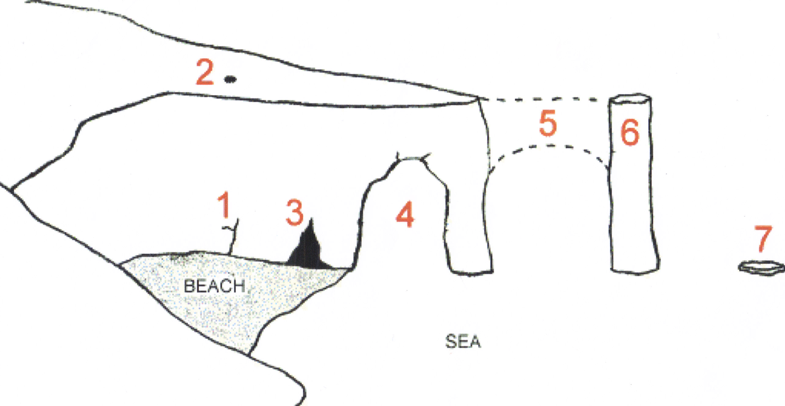
stack fault
stump collapsed arch
cave blowhole
arch

Slide 28
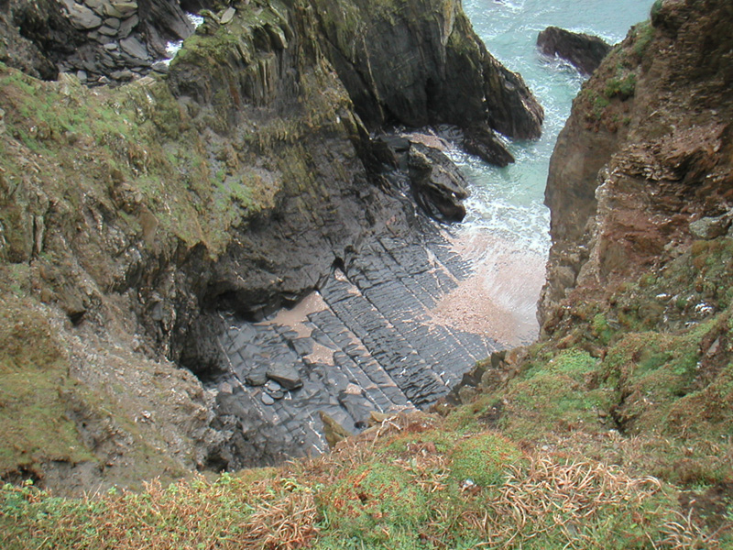
Chilli Hot Challenge
Research a wave-cut platform like this one found on Burgh Island, Devon.

Slide 29
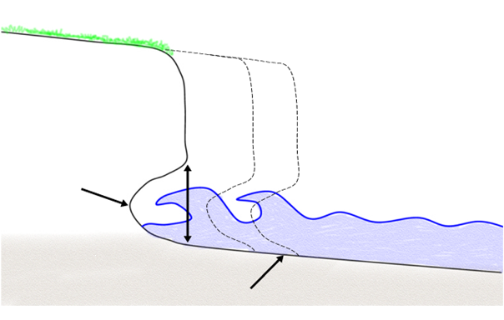
Chilli Hot Challenge
Look at this diagram.
Write an explanation of how you think a wave cut platform is formed.
Original position of the cliff
Cliff retreats
Present position of the cliff
Sea level (high tide.)
Wave cut notch at foot of cliffs
Wave cut platform.

Slide 30

Plenary
When have you seen examples of this in real life?

Slide 31
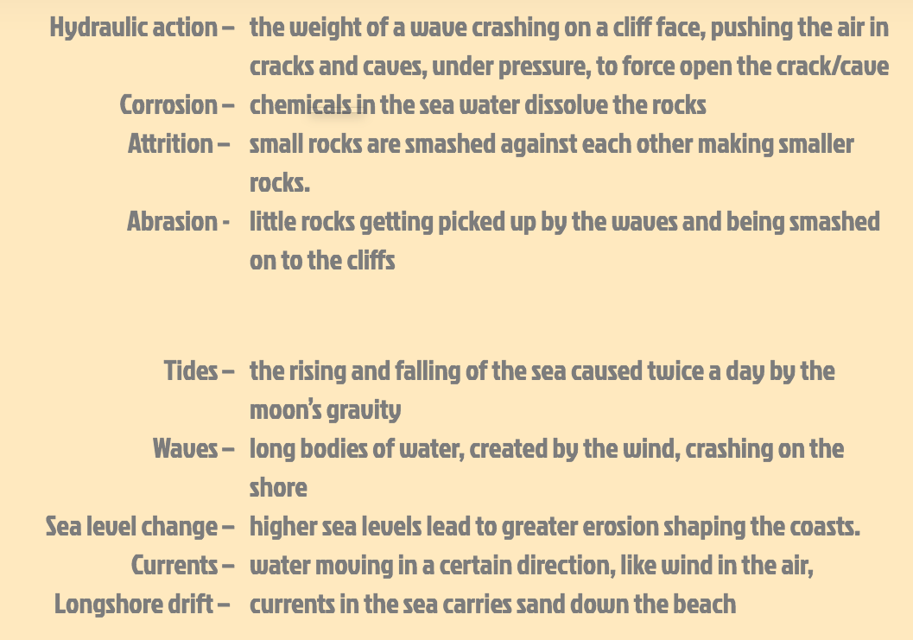

Slide 32
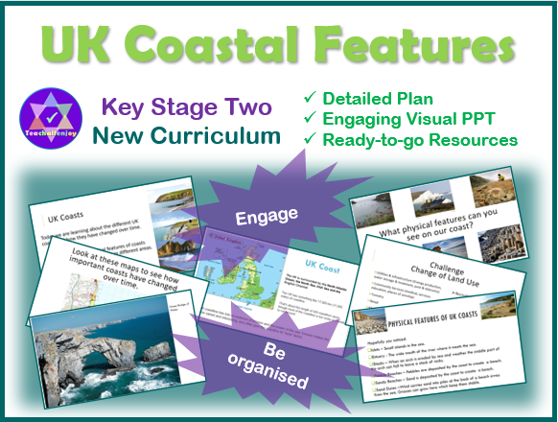

More Geography Lessons Available

