Slide 1
What Have We Done So Far?
Stage of learning so far…
1) Learn a story by an author using pictures and drama
2) Learn some excellent vocabulary from the author
3) Experiment with our own language choices
4) Design our own character
5) Consider adventurous words to describe our character

Slide 2
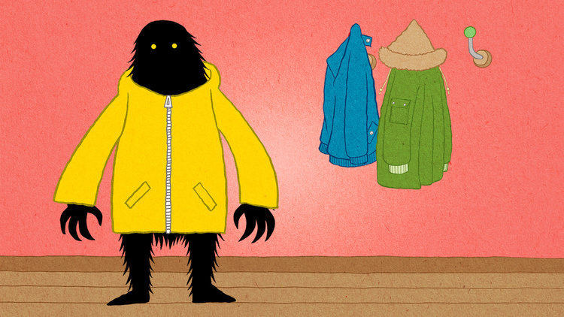
Yesterday, you all designed some brilliant beasts. You thought about:
Colour
Texture
Personality
Measurements

Slide 3
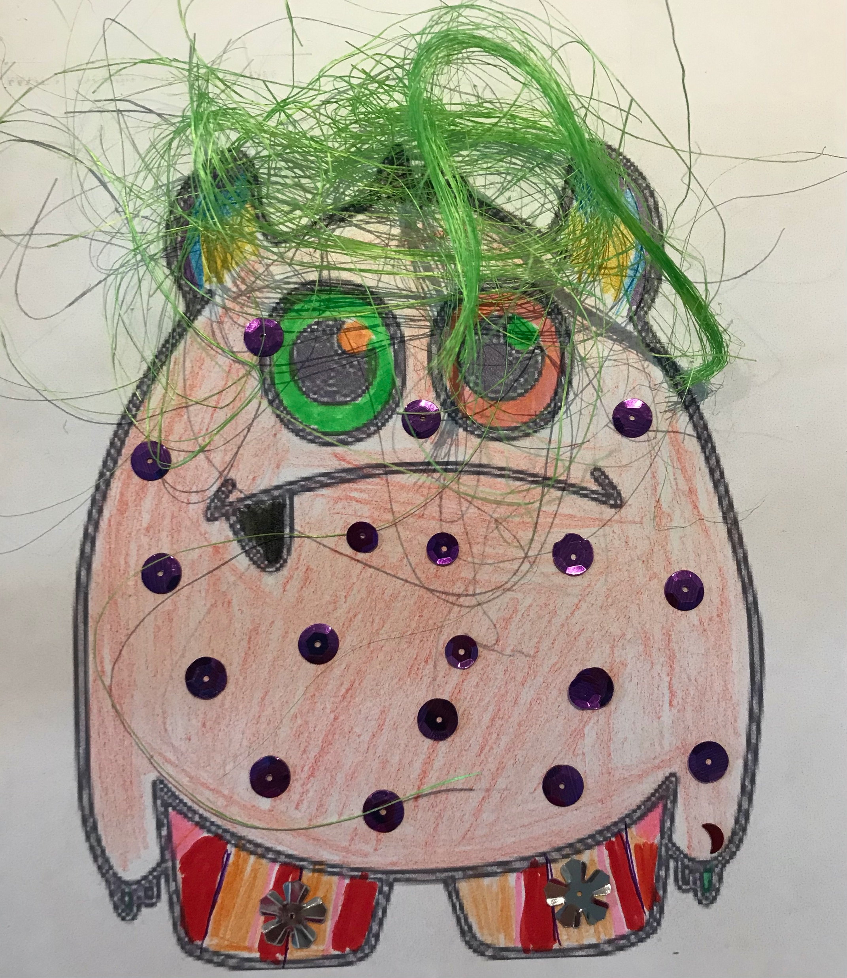
Mrs Simpson’s Beast!

Slide 4
Task:
Today you are going to build a vocabulary bank of adjectives to describe your beast.
You are going to write them around the outside of your picture like the example on the next page.
Remember to be adventurous with your choice of language so that it is exciting for your reader!

Slide 5
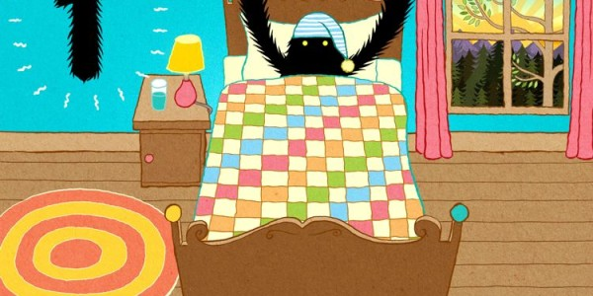
Some adjectives you might like to use:
Colour – bright, dark, light, illuminous, fluorescent, multi-coloured, rainbow-effect.
Texture – rough, smooth, hard, soft, furry, bony, coarse.
Measurements – enormous, large, tiny, titchy, gigantic, gargantuan, wide, narrow, thick, thin.
Personality - scary, happy, fierce, cute, cuddly, kind, helpful,
Habitat – cave, house, castle, underground, on a hill-top, jungle, desert, tree house, tropical island, cottage, forest.

Slide 6
Building a vocabulary bank.
Coarse, green hair
Huge, wide eyes
One green, one orange eye
Shiny, purple spots
Stripy red and
orange legs
Black tongue
Silver snowflakes

Slide 7
Final task
Check your choice of words are adventurous.
Send your work in via Dojo for feedback, celebration and sharing.
IMPORTANT - keep this work safe: you will need it for next week!

