Slide 1

Wednesday 18th November 2020
Today we will look at the end of our description using the class picture map.
WALT: Substitute vocabulary to write a description?
Success Criteria: Have I…
+ Substituted words with support?
+ Substituted words with appropriate alternatives?
+ Substituted words with ambitious vocabulary?

Slide 2

Preparation time: 10 minutes
1) Look at your work from yesterday. Read your description out loud using your best reading voice.
2) Can you act out your description of the Beast as you read it (just like we did in class?)

Slide 3
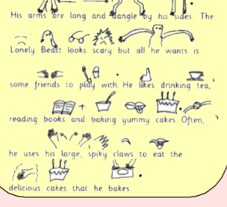
Today, we are going to focus on the second half of our description of the Beast.

Slide 4
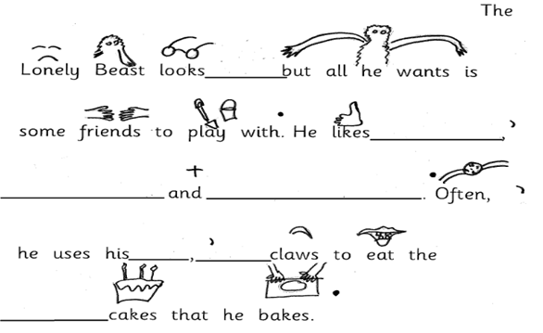
You will need 'Wednesday's Missing Words' worksheet for this.
Main Task: 20 minutes
Once again, some of the adjectives (describing words) have been taken out of our description. You need to replace them with new adjectives of your own. I have given you some ideas for the first one.
huge
frightening
dangerous
Think of your own words
for the rest of the spaces.

Slide 5
Final task
Final Task: 10 minutes
1) Read your work out loud in your best reading voice. Are you happy with the new adjectives you have chosen?
2) Can you send a picture of your work today to Mrs Simpson on Dojo?
3) Put your work somewhere safe please - you will need it tomorrow!

