Slide 1
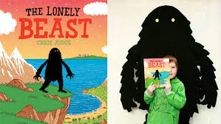
Thursday 19th November 2020
Today, you are going to design your own beast.
WALT: Design my own Beast

Slide 2
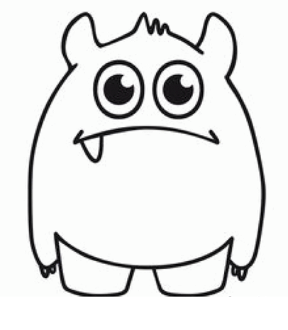
Preparation time: 10 minutes
1) Look at your work from Tuesday and Wednesday. Read your description out loud using your best reading voice.
2) Think about the adjectives (describing words) you used. Could you use any of those ideas for your own Beast design?

Slide 3
You will need to use the 'Design a Beast' worksheet
Main Task: 30 minutes
1) Find some colouring pencils, felt tips, materials to stick etc.
2) Give a big smile, as this is going to be super-fun!
3) Design your own beast using the worksheet provided. There is some help for you on the next slide.

Slide 4
When you design your beast think about how you would describe it.
Think about colours
green eyes
bright, blue eyes
light, pink eyes
dark, red tongue
black tongue
Think about measurements
huge claws
wide eyes
enormous feet
small ears
long, dangly arms
Think about textures (how things feel)
furry ears
sharp claws
soft, fluffy fur
rough, bumpy hands
wrinkly, long feet
Think about feelings - do you want it to look...
cuddly
scary
lonely
frightening
friendly

Slide 5
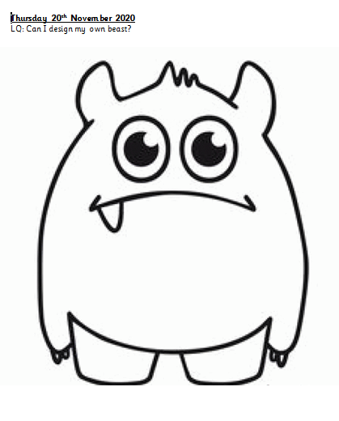
Now have some fun designing your own Beast.

Slide 6
Final task
Final Task: 10 minutes
1) Share your work with someone at home. Talk to them about how your beast looks.
2) Can you send a picture of your work to Mrs Simpson on Dojo?

