Slide 1
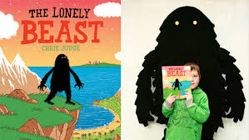
Monday 16th November 2020
Last week, we started reading a new book, The Lonely Beast.
We...
Read the book.
Wrote about the feelings and thoughts of characters in the book using coordinating conjunctions (and, but, so, or , as).
Wrote about how we felt about the Beast visiting our class
We used subordinating conjunctions (because, when, if, that) to write about the Beast.
We created a story map using pictures to help us remember and retell the story.

Slide 2
Monday 16th November 2020
Today, you will draw your own pictures to support our description of The Lonely Beast.
WALT: Create a picture map of a description?
Success Criteria: Have I…
+ Created drawings to support a description with support?
+ Created drawings to support a description?
+ Created drawings to support a description including punctuation?

Slide 3

Preparation time: 10 minutes
1) Listen to the Lonely Beast being read by two children, using this link... https://youtu.be/hibEHyuYYrs
2) Look at the class story map we drew together on Friday (next slide). Can you retell the story out loud using the pictures to help you?

Slide 4
You will need the 'Monday Full Description of Beast' sheet for this task.
Main Task: 20 minutes
1) Read through the Lonely Beast description sheet.
2) Can you draw pictures for the underlined words to help you remember what the Beast looks like?
Help? - You can use some of the drawings that we practiced as a class on Friday (look at the next page to see these).

Slide 5
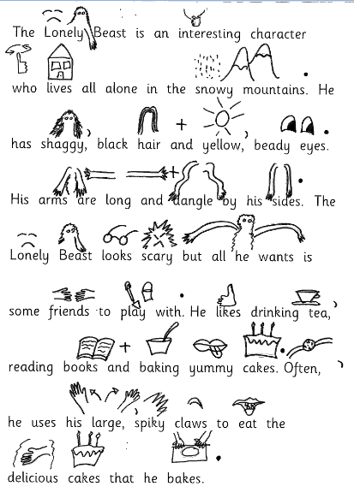
Our class ideas from Friday

Slide 6
Final task
Final Task: 5 minutes
1) Can you send a picture of your work to Mrs Simpson on Dojo?
2) Put your work somewhere safe please as you will need it tomorrow!

