Slide 1
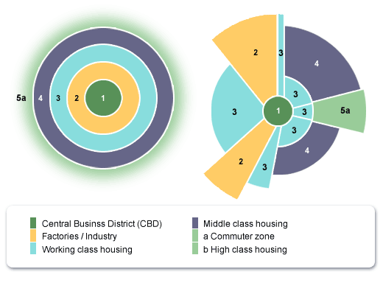
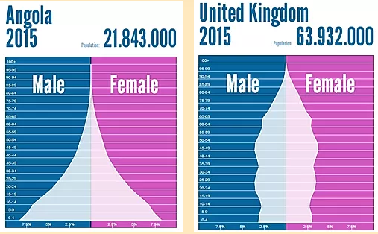
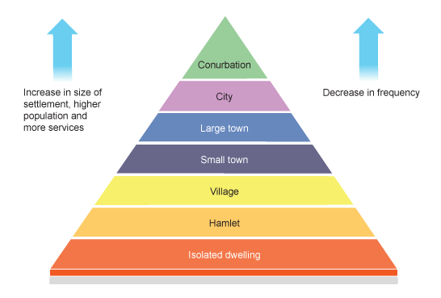
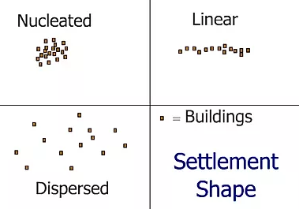
St Mary Cray Primary School – Knowledge Organiser
Geography Focus | Cities and Populations | Year 4 | Summer 1
What? (Key Knowledge)
How does population change? | Population changes as a result of natural increase/ decrease (the difference between the number of births and deaths) and migration.
Know the push and pull factors of urbanisation and immigration. | Pull factors: More facilities, more jobs, better education and health services, improved living conditions
 | Push factors: Unemployment, crop failure, few facilities, poor education.
Settlement locations | Originally settlements are situated near drinking water, resources, fertile lands, and defensive locations, trade ports.
How are settlements organised | Smaller settlements can be categorised by shape (linear, nucleated and dispersed) Larger settlements are organised through land use.
What are settlements called and what are they like? | Hamlet, village, town, city, mega city. Larger settlements have more facilities, opportunities and populations/
How do cities change across the world? | Cities in less developed countries are less organised, with slums and have greater inequality.
What? (Key vocab)
Spelling | Definition
Population | The number of people living in an area
Settlement | A place where people live and establish a community
Migrants | a person who moves from one place to another to live or work.
urbanisation | An area/ country becoming more urban
Urban | Towns or cities
Rural | The countryside
Population density | Number of people divided by the land area.
Immigrants | A person who moves from one country to another to live or work
Land use | The way land is used by people
CBD | Central Business District
Death rate | The number of deaths per year
Birth rate | The number of births per year
Multicultural | An area made up of many cultures, religions or ethnicities.
Diagrams and Symbols
Homework

