Slide 1
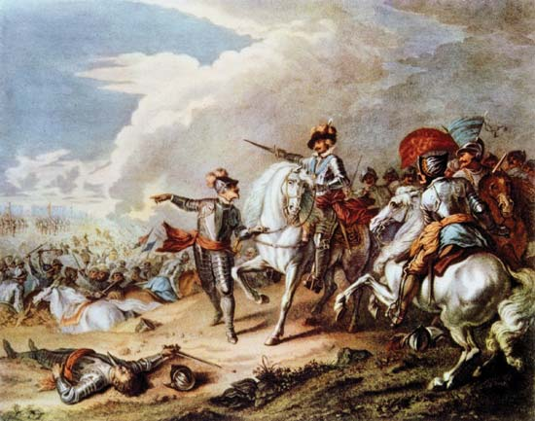
St Mary Cray Primary School – Knowledge Organiser
History Focus | The Civil War | Year 4 | Summer 2
When? (Key Knowledge)
1629 | Charles I dissolved parliament and rules without them. He raised money through taxing people..
1640 | Charles was forced to recall parliament as needed money to fight the Scots.
1644 | Battles of Marston Moor – Charlies defeated parliament
16:45 | New model army created
1945 | Parliament defeated Charles.
1648 | Battles of Preston
1649 | Execution of Charles I
Background Information
To understand who the two different sides during the civil war were, and why the roundheads won. To consider why Parliament decided to kill Charles I. To find out why the people wanted Charles II to return to England and become King. To investigate why the Great Fire of London spread so quickly through the city. To understand what was so ‘glorious’ about 1688 To understand why the Bill of Rights was passed.
What? (Key vocab)
Spelling | Definition
Cavalier | The nickname given to the Royalists, who fought for the King
Roundhead | The nickname given to those who fought for Parliament; many Puritans wore their hair very short / cropped
Civil war | A war between different groups within the same country
Republicans | This group was led by Oliver Cromwell, believed that Parliament should rule the country
New Model Army | Fulltime. Highly disciplined, professional army set up by Oliver Cromwell; Puritan; vital in defeating Charles I
Diagrams and Symbols
Who?
Oliver Cromwell | Developed the New Model Army Republican Defeated the king
Samuel Pepys | Wrote a diary about The Great Fire of London

