Slide 1

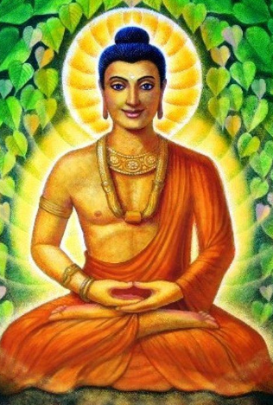
St Mary Cray Primary – Knowledge Organiser
RE Focus | Buddhism: Beliefs into practices | Year 4 | Summer 1
What? (Key Knowledge)
Enlightenment | Enlightenment is when a Buddhist finds the truth about life and stops being reborn because they have reached liberation.
Siddhartha | The man who became known as the Buddha. Siddhartha had lived a life of luxury as an Indian Prince. He realised there was suffering in the world and wanted to understand why.
Noble Eightfold Path | The path of Buddhist practices leading to liberation from the cycle of rebirth. The Eightfold Path consists of eight practices: view, resolve, speech, conduct, livelihood, effort, mindfulness, and meditation.
Attainment Targets
I can describe one of my ‘good’ choices and the consequence of it. I can also explain the consequences of making a different choice. I can describe how aspects of the 8-fold path would help Buddhists know how to live good lives. I can start to tell you why some aspects of the 8-fold path might be hard for some Buddhists to stick to.
Key Questions
What is the best way for a Buddhist to lead a good life? Do religious people lead better lives? Do all religious beliefs influence people to behave well towards other?
What? (Key vocab)
Spelling | Definition
Buddhist | A Buddhist is someone who follows the teachings of a man called Siddhartha Gautama (or Siddattha Gotama), who became known as the Buddha.
Liberation | The action of setting somebody free.
Mandala | A circular figure representing the universe in Hindu and Buddhist symbolism.
Monk | A man in a religious order who lives a life of poverty and obedience. A Buddhist monk lives with other Buddhists and follows strict life rules.
Possible experiences
Make a list of 8 things that would help the class feel safe and happy e.g. kind words.
Visual representation of Siddhartha during the time of enlightenment.

