Slide 1

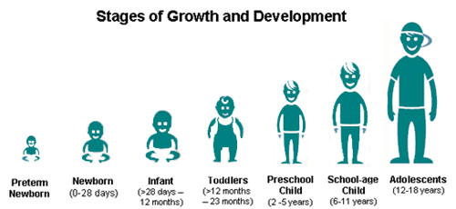
St Mary Cray Primary School – Knowledge Organiser
Science Focus | Animals, including humans | Year 5 | Spring 1
What? (Key Knowledge)
The human reproductive system
What is fertilisation? | The male and female sex cells fuse together.
What is puberty? | Usually, puberty starts between ages 8 and 13 in girls and ages 9 and 15 in boys. At that stage, their pituitary gland (a pea-shaped gland located at the bottom of your brain) releases special hormones that change and mature the body ready for reproduction.
Becoming old | As you get older, your skin wrinkles because it becomes thinner and less elastic. It gets drier too as it makes less oil and sweat. Your bones become more visible as you store less fat beneath your skin. Inside the body your bones and muscle become weaker. Your memory gets worse, and your immune system cannot fight disease as easily.
Statutory requirements
Describe the changes as humans develop from birth to old age.
What? (Key vocab)
Spelling | Definition
Gestation | The process or time when prenatal development takes place before birth.
Fertilisation | The process of the male and female sex cells fusing together.
Reproduce | To produce young.
Prenatal | The cells develop and grow into a foetus inside the mother’s uterus. After around 9 months, the baby is born.
Newborn | A human infant that is less than 28 days old.
Infant | Child under 1 year of age.
Toddler | Child aged 12-36 months.
Child | Human aged 3-11 years.
Adolescent | Human aged 12-18 years old.
Elderly person | The final stage of life – often defined as over 60/65 years.
Hormones | Hormones are your body's chemical messengers.
Puberty | The period during which adolescents reach sexual maturity and become capable of reproduction.
Pictures and Diagrams
Possible experiences
Invite guests in to share their experiences e.g. parent with a newborn child, an elderly person. Measure children from different year groups in the school – from Nursery to Year 6. What can they do? What milestones have they passed. For homework, talk to your parent and make a list of your personal milestones – when did you say your first words, when did you walk?

