Slide 1


The revised Early Years Foundation Stage (EYFS)
Early Adopter Schools
Information for parents of babies, toddlers, Nursery and Reception aged children.
This year Spring Trust Schools have chosen to become Early Adopters of the new Early Learning Goals and Development Matters. Please see our letter from the Spring Trust for further information on why we have chosen to do this.
This power point aims to share with you the seven features of effective practice based around the new Early Learning Goals (end of Year Assessment) and the new Development Matters Framework.

Slide 2

The best for every child
All children deserve to have an equal chance of success
High quality education is good for all children. It is especially important for children from disadvantaged backgrounds and we all need to continue to do more to narrow the gap
Children who have lived through difficult experiences can begin to grow stronger when they experience high quality early education and care
High quality education is inclusive. Children with special educational needs and disabilities are identified quickly and receive extra help so they can progress well in their learning.

Slide 3

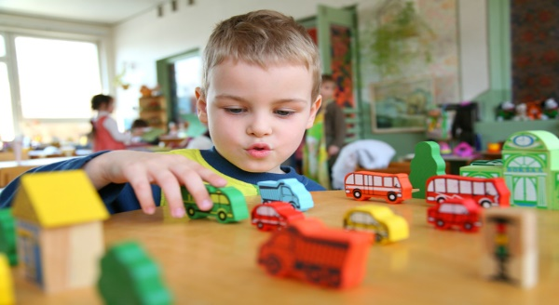
High Quality Care
The child’s experience must always be central to their starting points
Babies, young children and toddlers thrive when they are loved and cared for.
High quality care is consistent. Practitioners need to enjoy spending time with young children.
Effective practitioners are responsive to children and babies. They notice when they are happy or sad.
Practitioners know that toddlers and young children are learning to be independent and will sometimes get frustrated.
Practitioners know that starting school and all other transitions in the early years are big steps for small children and their families

Slide 4

The curriculum: what we want our children to learn
The curriculum is a top level plan of everything the early years setting wants the children to learn.
Planning to help every child to develop their language is vital
The curriculum is ambitious with careful sequencing so children can build their learning over time.
Young children’s learning is driven by their interests so planning is flexible
Babies and young children do not develop in a fixed way. Their development is like a spiders webs with many strands not a straight line
Depth is more important than covering lots of things in a superficial way.

Slide 5

Helping children to learn
Children are powerful learners and every child can make progress with the right help
Teaching needs to have different approaches. Children learn through play with adults modelling, by observing each other and through guided learning and direct teaching
Our environments are planned for high quality play. Sometimes children have space to play on their own. Sometime adults join in sensitively to support and extend learning
Children in the early years also learn through group work with teachers guiding them. Older children need more of this guided learning.
A well planned environment is crucial to this.

Slide 6
Assessment-checking what children have learnt
Assessment means noticing what children can do and what they know. It is not about lots of data and evidence
Effective assessment means that adults must understand about child development
Accurate assessment can highlight if a child has special educational needs and needs extra help
Before assessing children it’s useful to think about what assessments will be useful
Assessment should not take the adults away from the children for long periods of time
The Early Learning Goals continue to be the way that children are assessed at the end of the Reception Year. Data will still be submitted to the Local Authority but schools will now moderate assessments across the trust. Exceeding descriptors have been removed.

Slide 7

Self Regulation (controlling emotions)
Executive function means the ability for a child to..
-hold information in their mind
-focus their attention
-regulate their behaviour
-plan what to do next
These abilities help the child to self regulate so that they can
-focus their thinking
-monitor what they are doing and adapt
-regulate strong feelings
-be patient for what they want
Bounce back after difficulties
Language development is central to self regulation. Children use language to guide their actions and plans. Pretend play gives them lots of opportunities to focus their thinking and plan ahead

Slide 8



Partnership with parents
-It is important for parents and early years settings to have a strong respectful partnership. This means that children will thrive.
-We listen to parents and give them clear information about their child’s progress.
-The help that parents give at home has a significant impact on their learning. When a child gets less support at home, by knowing the child, the settings can offer extra support for those who need it most
-Parents are encouraged to chat, play and read with their children.

