Slide 1

Religious Education – Christianity
Concept: Salvation
Is anything ever eternal?

Slide 2
LQ: Can I understand the definition of eternity and explain what it means to me?
What do you think these words mean:
eternity
eternal
infinite
immortal

Slide 3
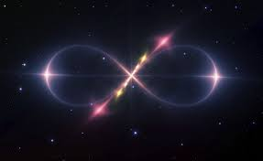
LQ: Can I understand the definition of eternity and explain what it means to me?
Eternity: infinite or unending time
Eternal: lasting or existing forever; without end

Slide 4

LQ: Can I understand the definition of eternity and explain what it means to me?
Write a definition of the word eternity
Eternity: infinite or unending time
Eternal: lasting or existing forever; without end
2. Draw a small illustration to represent the word

Slide 5
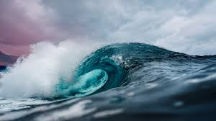






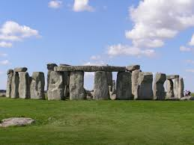
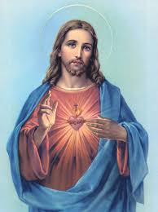

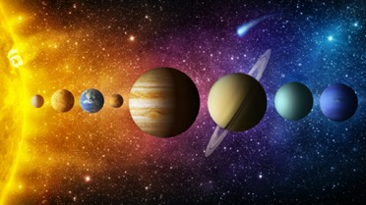
Which of these will last forever?

Slide 6
Could we put things into categories?
Has lasted my lifetime I think will last forever I wish would last forever
Notes:
In books – create this table populate each category.

Slide 7

What do you think?
Does anything last forever?
Doesn’t everything change all the time?

