Slide 1
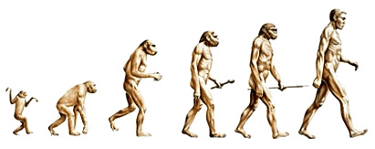
Evolution and Inheritance

Slide 2
LQ: Can I recognise that living things have changed over time and that fossils provide information about things that lived many years ago?

Slide 3
What do you already know about…
Inheritance
Adaptation
Evolution
Fossils
Notes:
Talk Partners: Give children time to talk to their partner to discuss what they did in Year 3 on fossils and asses their prior knowledge of inheritance, adaptation, evolution and what they already know about Charles Darwin.

Slide 4
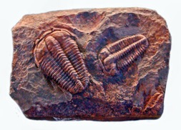
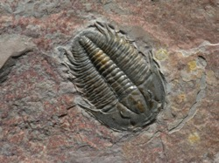
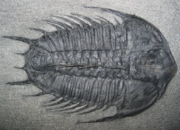
What are fossils?
Fossils are the stone remains of dead animals or plants.
Fossils are usually the skeletons of animals and plants but not always. They can also be things made by animals like footprints or poo! Sometimes a whole animal can get trapped in ice, freezing them for thousands of years.
Palaeontologists have found woolly mammoths that have been preserved this way.
Notes:
If you have fossils in schools, give children some time to look at them and feedback what they notice.

Slide 5
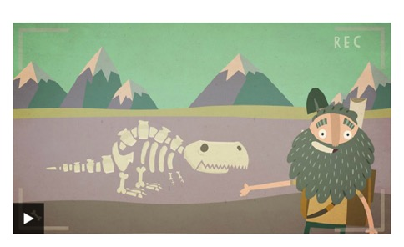
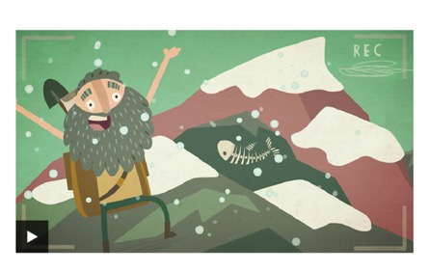
How are fossils formed?
What can we learn from fossils?
Notes:
Link to BBC Bitesize: https://www.bbc.co.uk/bitesize/topics/z9bbkqt/articles/z2ym2p3
https://www.bbc.co.uk/bitesize/topics/z9bbkqt/articles/z22g7p3

Slide 6
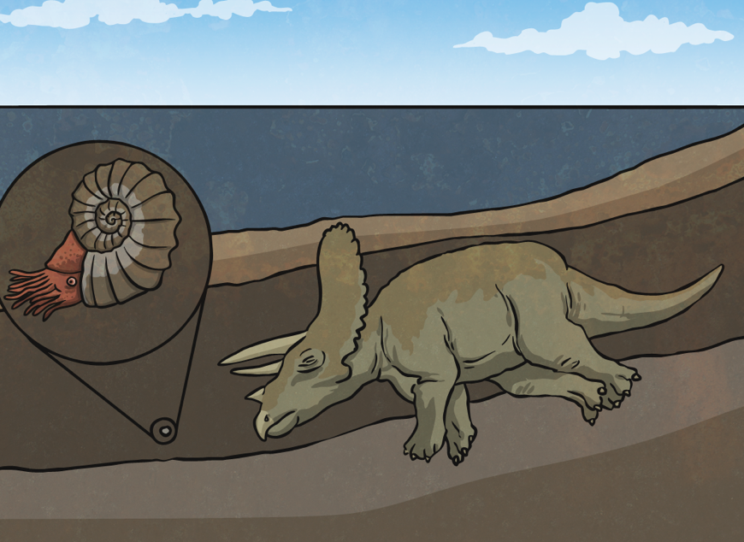
An animal or creature dies. Its remains get covered in mud and dirt over time.

Slide 7
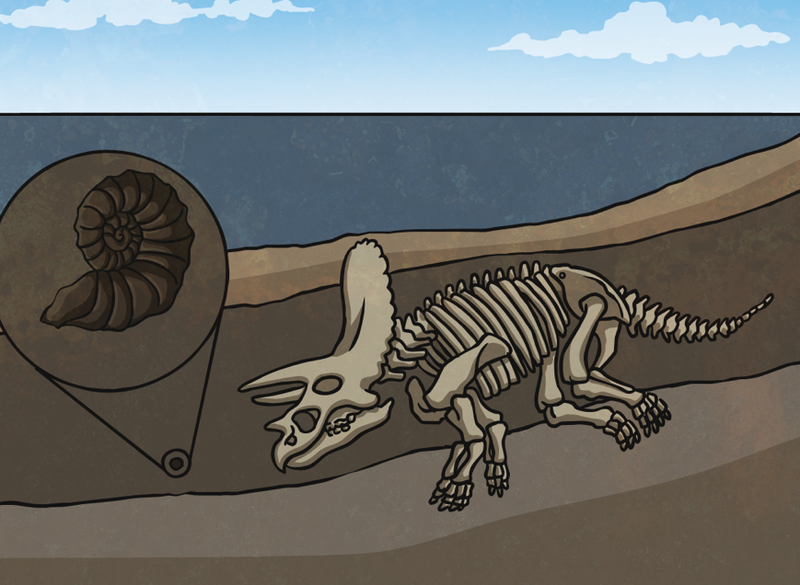
Over thousands of years, pressure builds up from all the layers of rock and mud covering the skeleton. The skeleton is dissolved by ground water. This makes a perfect mould of the skeleton.

Slide 8
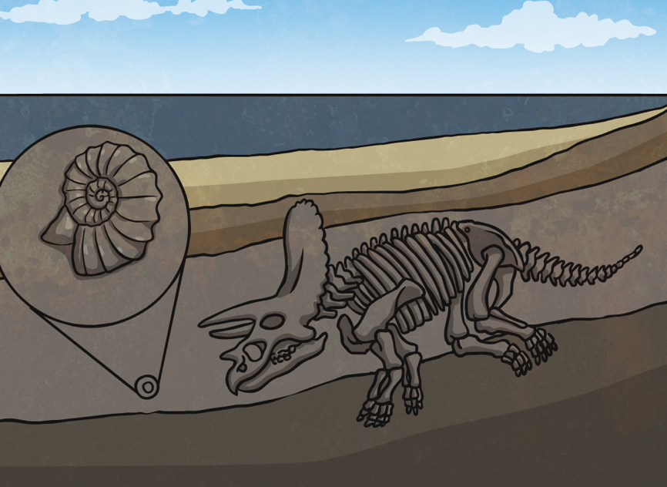
Minerals in the ground water begin to fill the mould of the skeleton. These minerals form rock within the mould (this takes at least 10,000 years).

Slide 9
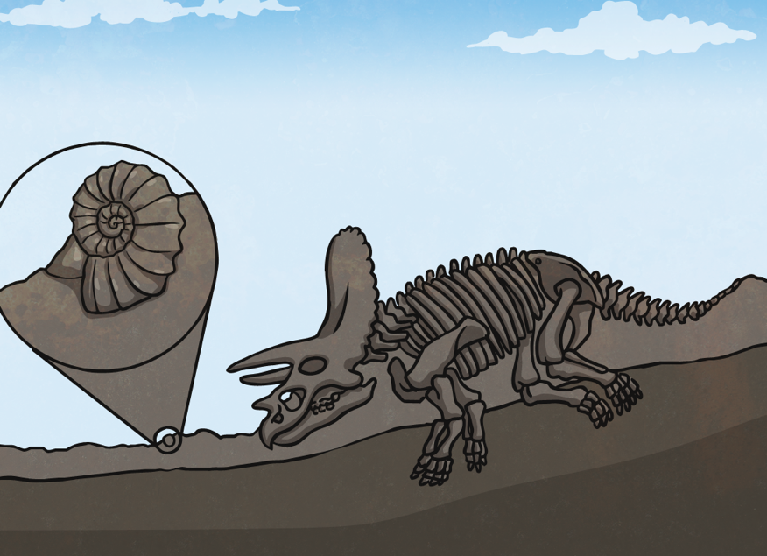
Finally all that’s left is a perfect fossilised skeleton. Over time, the layers of rock and earth erode away leaving the fossil to be found.

Slide 10
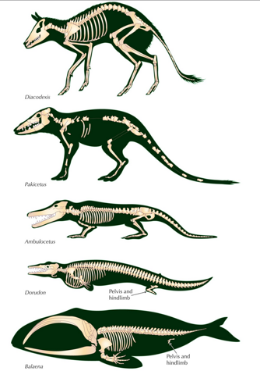
Fossils and Evolution
For example, palaeontologists think that these fossil skeletons show how whales might originate from land animals.
Fossils are very useful for telling us more about how animals and plants have evolved over time.

Slide 11
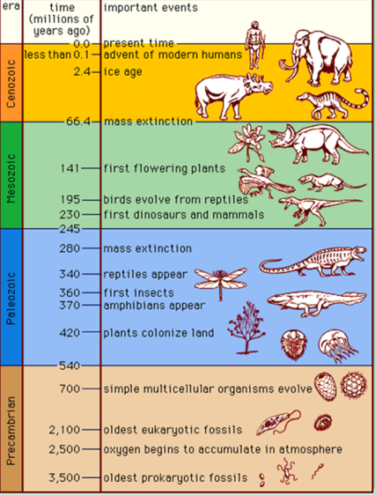
What do fossils tell us?
What living things looked like
How long ago they lived
What living things were alive millions of years ago
How living things have evolved
How different things are related to each other
How long it existed

Slide 12
Quiz time…
Fossil
The study of the history of life on Earth as based on fossils
Skeleton
Internal or external framework of bone and cartilage supporting the body of an animal
Evolution
Remains or impression of a prehistoric plant or animal embedded in rock and preserved
The process by which living organism are believed to have developed from earlier forms during the history of the Earth
Erode
Palaeontology
Be gradually worn away by natural agents

