Slide 1
Objective: To explore the work of a range of artists, craft makers and designers, describing the differences and similarities and making links to their own work.
Printing

Slide 2
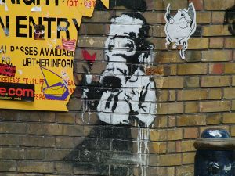
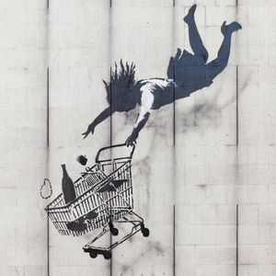
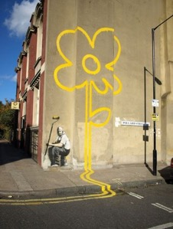
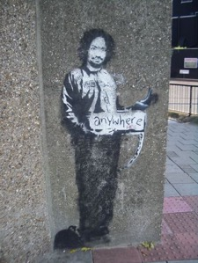
Banksy is a British street and graffiti artist. He likes to remain anonymous and not let people know his true identity. He often draws in high visibility public places such as on buildings or train stations. His paintings are often about politics, war and other important topics.
Banksy

Slide 3
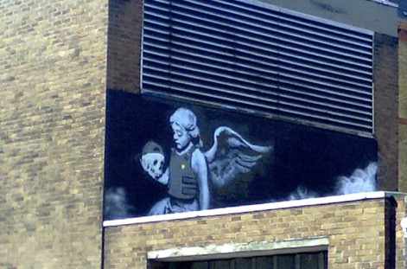
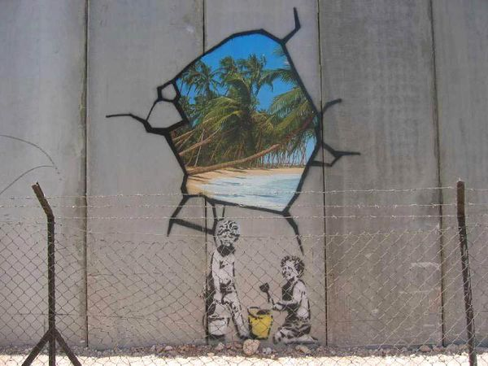
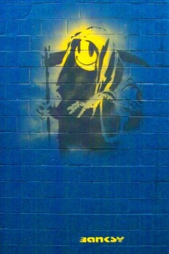
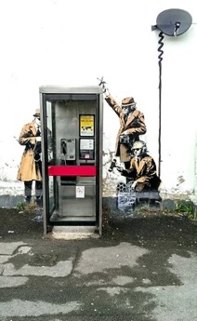

Slide 4
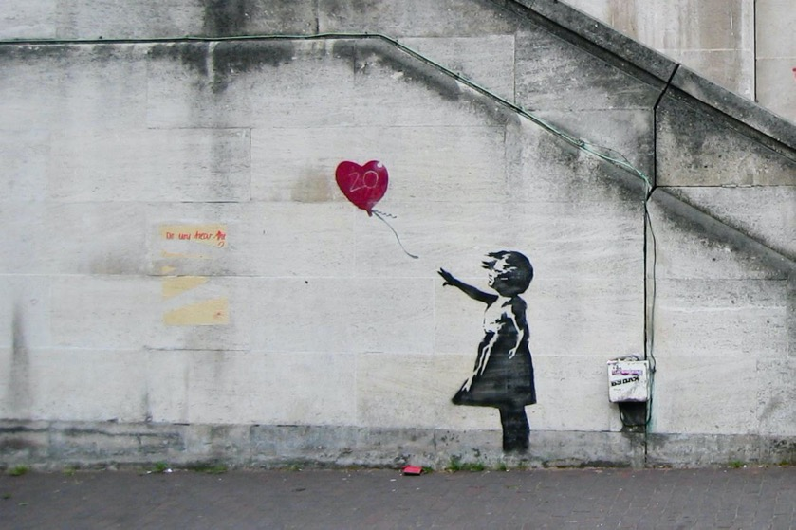
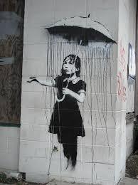

Slide 5
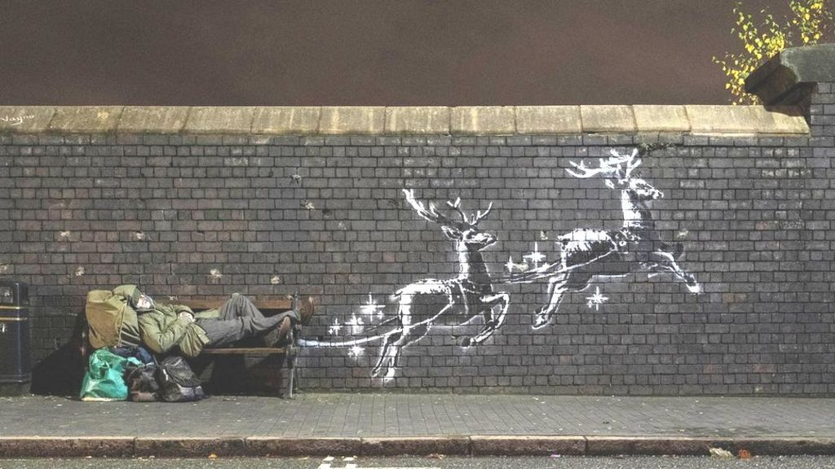
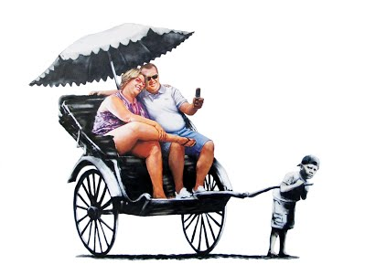

Slide 6
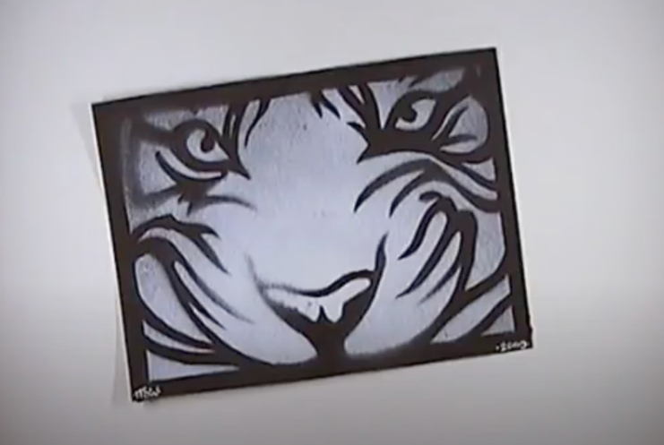
Stencils
Notes:
Click on image - Link to You Tube video: https://www.youtube.com/watch?v=yHsojM5d5no
Children to attempt to create their own image and create a stencil from that or choose a silhouette of an animal to trace around and use that.

Slide 7
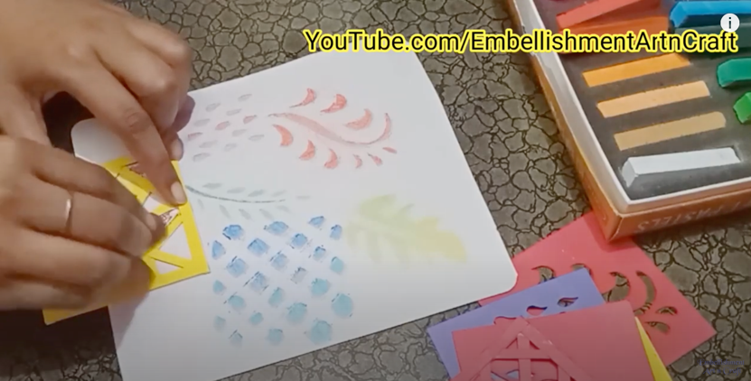
Stencils
Notes:
Click on image - Link to You Tube video: https://www.youtube.com/watch?v=YdpDk4V4Yy0

Slide 8





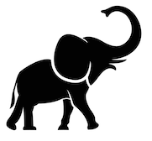
Stencils
Notes:
Or let children choose one from the selection given…Some are a a lot more complex than others.

