Slide 1


R1: Child as a Reader
R1e: Can construct visual images
= teacher’s notes
Commissioned by The PiXL Club Ltd.
August 2018
This resource is strictly for the use of member schools for as long as they remain members of The PiXL Club. It may not be copied, sold nor transferred to a third party or used by the school after membership ceases. Until such time it may be freely used within the member school.
All opinions and contributions are those of the authors. The contents of this resource are not connected with nor endorsed by any other company, organisation or institution.
© Copyright The PiXL Club Limited, 2018

Slide 2

Parent Notes
This therapy is designed to help children understand how to construct visual images while they read.
Pupils will learn that we construct images as we read based not only on the author’s description, but also on our own prior knowledge of a situation.
Pupils will think about what they see, smell, hear, taste and feel when reading and what pictures/video clips go through their minds when reading.
Throughout the therapy, there are opportunities for pupils to discuss and practise the taught skills using a range of texts.

Slide 3
It is now widely believed that images play a functional role in cognition.
Proficient readers spontaneously and purposely create mental images while and after they read. The images emerge from all five senses, as well as the emotions, and are anchored in a reader’s prior knowledge.
Keene and Simmerman, Mosaic of Thought
Constructing visual images:-
Helps children to use their imagination and encourages a link between reflection, experience and prior knowledge, allowing them to create and understand more detailed and descriptive text.
Helps children to shape their ideas and expand their thinking.
Improves comprehension skills as children can recall details better.

Slide 4
When we are reading, it is important that we are able to construct (build) visual images (pictures) in our minds to help us engage with and understand the text we are reading.
When we construct visual images, we use three different things:
Our senses
What the text and the description within the text makes us:
see
hear
feel
smell
taste
2. Our emotions – does the text make us scared, worried, happy, upset?
3. Our prior knowledge/experience – what we already know about the subject in the text and how we have felt about it before. This links back to emotion too as the text may remind us of a happy/sad time in our lives.

Slide 5
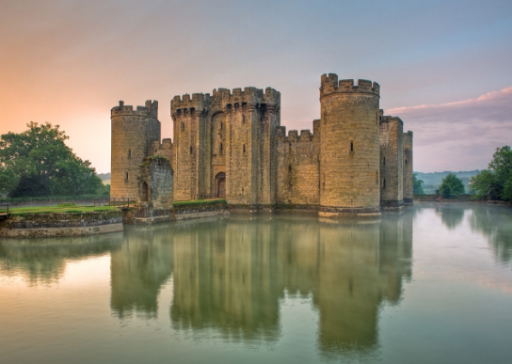
Constructing images with pictures
Discuss this picture or think about it independently and mind map your ideas.
Senses:
What does this picture make you:
See?
Hear?
Feel?
Smell?
Taste?
Prior knowledge:
What does this picture remind you of?
Have you been to a castle?
What stories/ experience have you got of castles?
Which words do you associate with castles?
Emotions:
What does this picture make you feel inside?
We are all likely to have different ideas based on our life experiences.

Slide 6
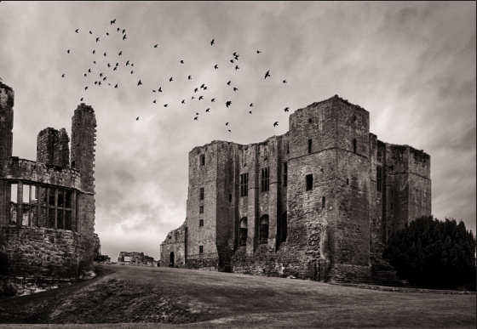
Constructing images with pictures
Now try the same with this picture. How are your visual images different from the last picture? Why do you think this is?
Senses:
What does this picture make you:
See?
Hear?
Feel?
Smell?
Taste?
Prior knowledge:
What does this picture remind you of?
Have you been to a castle?
What stories/ experience have you got of castles?
Which words do you associate with castles?
Emotions:
What does this picture make you feel inside?
We are all likely to have different ideas based on our life experiences.

Slide 7
Constructing (building) visual images
The first castle scene is calm and still and in colour. It may make us imagine historical castles, people living peacefully in castles and fairy tale/storybook castles. It may make us think of stories about kings and queens, castles and knights. It may look like a castle you have visited, seen on the television or in a non-fiction book.
The second castle scene is more sinister. The photographer has chosen to use black and white instead of colour, the castle is very imposing and there is a disused building to the side of it. There are also birds circling overhead. This may make us imagine people being trapped in dungeons/towers, people with ill intent/bad people from stories living here. It may make us think of scary storylines such as ghosts and haunted places or vampires.
What visual images did you construct of the two castles? Were your ideas similar or different to the above?

Slide 8
The photographers who took the castle images had very different ideas about what they wanted people to think about their castles. They would have had different visual images in their minds about what scene they wanted to create and how they wanted to make people feel about the castles.
Authors do the same as these photographers in their writing. Instead of colour and how they choose to present their photos, they use language and vocabulary choices to help us create visual images.

Slide 9
Constructing visual images from text
Close your eyes (if you feel comfortable to) and listen to the text in green being read aloud by a parent or sibling. Try to imagine the scene inside your head. Talk about what else you can see in the picture you have created in your head.
Remember to think about:
Senses: What you can see, hear, smell, taste, feel
Emotions: How does the text make you feel inside? Scared, excited, happy, upset?
Prior knowledge: What do you already know about the subject of the text? What experiences do you have of what is in the text/what stories have you read with similar content?
It was well into the afternoon and quickly getting dark. How long would she have to wait? She glanced up and down the empty road. The wind had dropped completely and everything was so unusually still that it felt like the world had come to a strange and eerie pause. A thin mist began to drift along the road like a slow, grey smoke. She felt suddenly cold and uneasy as the damp air clung around her face and a fine rain began to scatter around her, like sprinkling dust, in the early evening air.

Slide 10
This time, listen to the description in yellow being read aloud to you by a parent or sibling and draw what you hear
Remember to think about:
Senses: What you can see, hear, smell, taste, feel.
Emotions: How does the text make you feel inside? Scared, excited, happy, upset?
Prior knowledge: What do you already know about the subject of the text? What experiences do you have of what is in the text/what stories have you read with similar content?
The room I spied before me was quite square with a large window on the right side wall. Under the window there was a wooden coffee table which had heaps of old magazines piled on top. Beside the coffee table, next to the window, towered a huge grandfather clock which ticked loudly as the large brass pendulum swung from side to side.
On the other side of the window, a large picture depicting wild green hills and valleys decorated the otherwise bare walls of the dusty dining room.
In the centre of the room stood a long, rectangular table which had been neatly and appropriately set with fine silver cutlery and place mats. At the far end of the room, I could just make out the shape of an enormous fireplace, a welcoming fire roaring in its grate.
But then I spotted what I had been looking for. To the left of the fireplace, in the furthermost corner of the room, was a large wooden box with shiny brass hinges and a strange wooden figure of an owl perched proudly on top of it.

Slide 11
Your turn
Read the description and try to record your visual images either by drawing or mind mapping your ideas.
I stepped inside the cave. It was dark, darker than I had ever known it before. But just then, shards of bright moonlight fired in through the entrance, lighting up wispy threads of damp mist which curled around the small crevices on the mossy walls. Together, they created an eerie shadow all around me.
In the half light, I could see large jagged shapes sticking out from the walls. Silvery webs, silhouetted by the moon’s glow, clung all around them, heavy with misty dewdrops, all waiting to trap lunch for their sinister owners. Strange pointed shadows hung threateningly from the ceiling like icicles from a rooftop.
The ground felt rough and uneven beneath my feet as large tufts of mossy plants squeezed up between the stones and gave a slippery coating, making it difficult for me to keep my balance.
Long vines, like tentacles, touched my hair as I moved and made me flinch and shudder. I wrapped my jacket tighter around me as the cold air bit deeper into my clothes and turned my skin to goose bumps. Reaching out in front of me, I cautiously touched the wall to steady my steps but it felt so slimy and damp that I quickly pulled back my hand, wiping it on my jacket.
Notes:
NOTE: You may like to print this extract.

Slide 12
Your turn
Read this poem and try to record your visual images either by drawing or mind mapping your ideas.
Shadow March – Robert Louis Stevenson
All around the house is the jet-black night;
It stares through the window-pane;
It crawls in the corners, hiding from the light,
And it moves with the moving flame.
Now my little heart goes a beating like a drum,
With the breath of the creeping chill in my hair;
And all around the candle and crooked shadows come,
And go marching along up the stair.
The shadow of the bannisters, the shadow of the lamp,
The shadow of the child that goes to bed –
All the wicked shadows coming tramp, tramp, tramp,
With the black night overhead.
Notes:
NOTE: You may like to print this extract.

Slide 13
When reading, remember to use:
1. Your senses
2. Your emotions
3. Your prior knowledge/experience of the
subject
This will help you to construct visual images and deepen your understanding of the text you are reading.

Slide 14
Extension activity to improve the ability to construct visual images
Use music or scented candles to improve imagination and use of the senses.
Parents: Play music or sounds whilst describing a scene from a beach or wood or busy shopping street. Ask your child to draw what they visualise from your descriptions.

