Slide 1
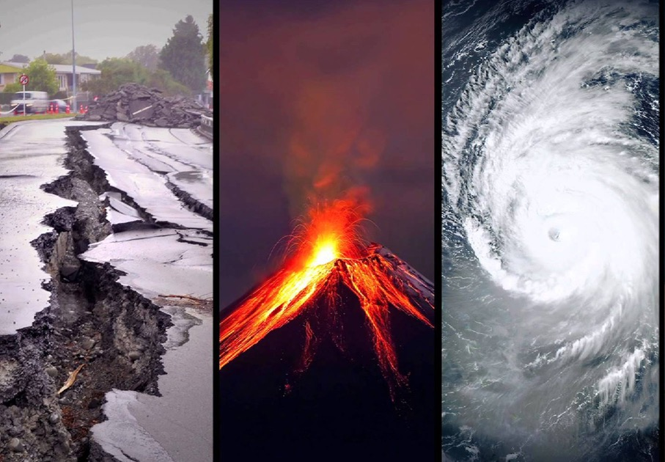
Natural Disasters
WALT: identify different climate zones

Slide 2
What do you already know?
What extreme weather phenomenon have you heard of?
Have you experienced any extreme weather in real life?
What have you seen in films/read about in books?
https://www.youtube.com/watch?v=yrOYxLt9SCI
Notes:
TP Children to recap on previous learning. What do they already know about extreme weather and different climates?
Show extreme weather clips. https://www.youtube.com/watch?v=yrOYxLt9SCI

Slide 3
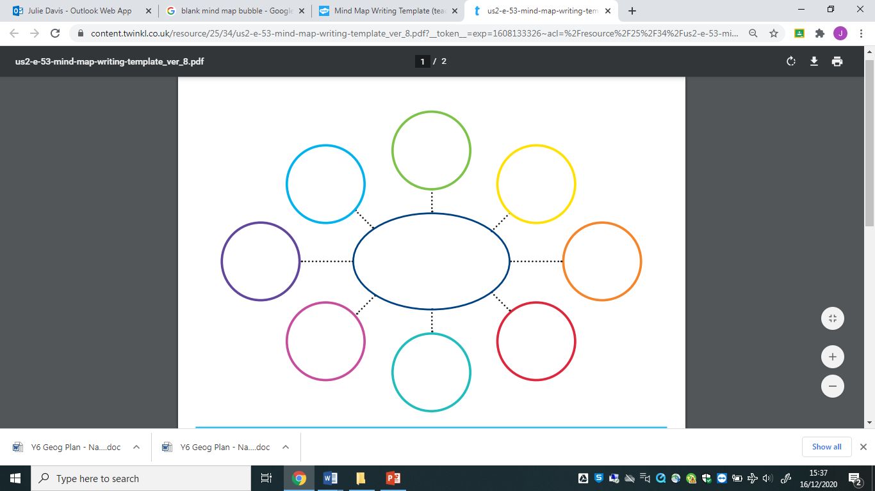
Let’s create a mind map of what we know…
Notes:
Create mind map or thought cloud with the different types and clarify of the terminology.

Slide 4
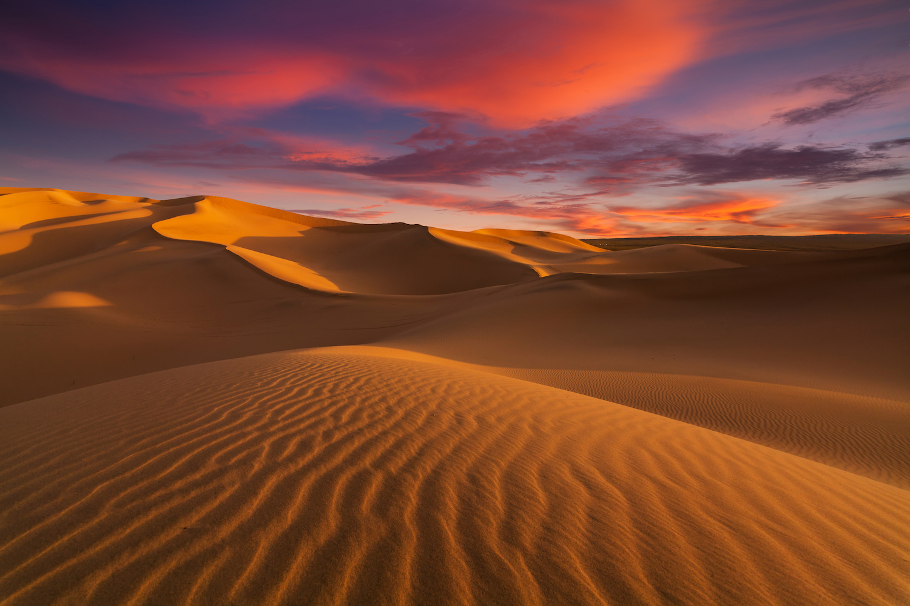
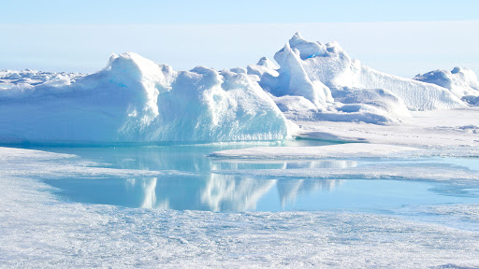
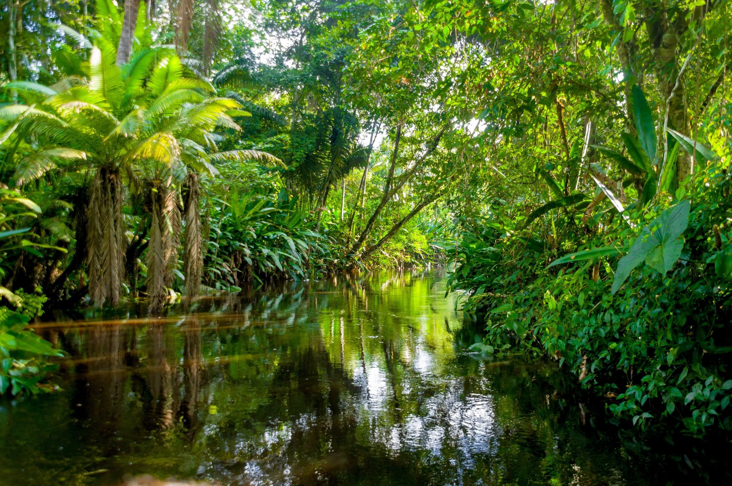
What places are…
…hotter than the UK?
…colder than the UK?
…drier than the UK?
…wetter than the UK?
Notes:
Ask chn to name different places that are hotter, colder, drier and wetter than the UK.
They should be able to include examples such as the Sahara Desert (hotter and drier), the Arctic (colder) and the Amazon Rainforest (wetter).
Using atlases, identify different climate zones around the world and look at how climates change around the poles and the equator. Identify countries in the world that have extreme weather conditions, including temperature and precipitation using the information in the atlases.

Slide 5
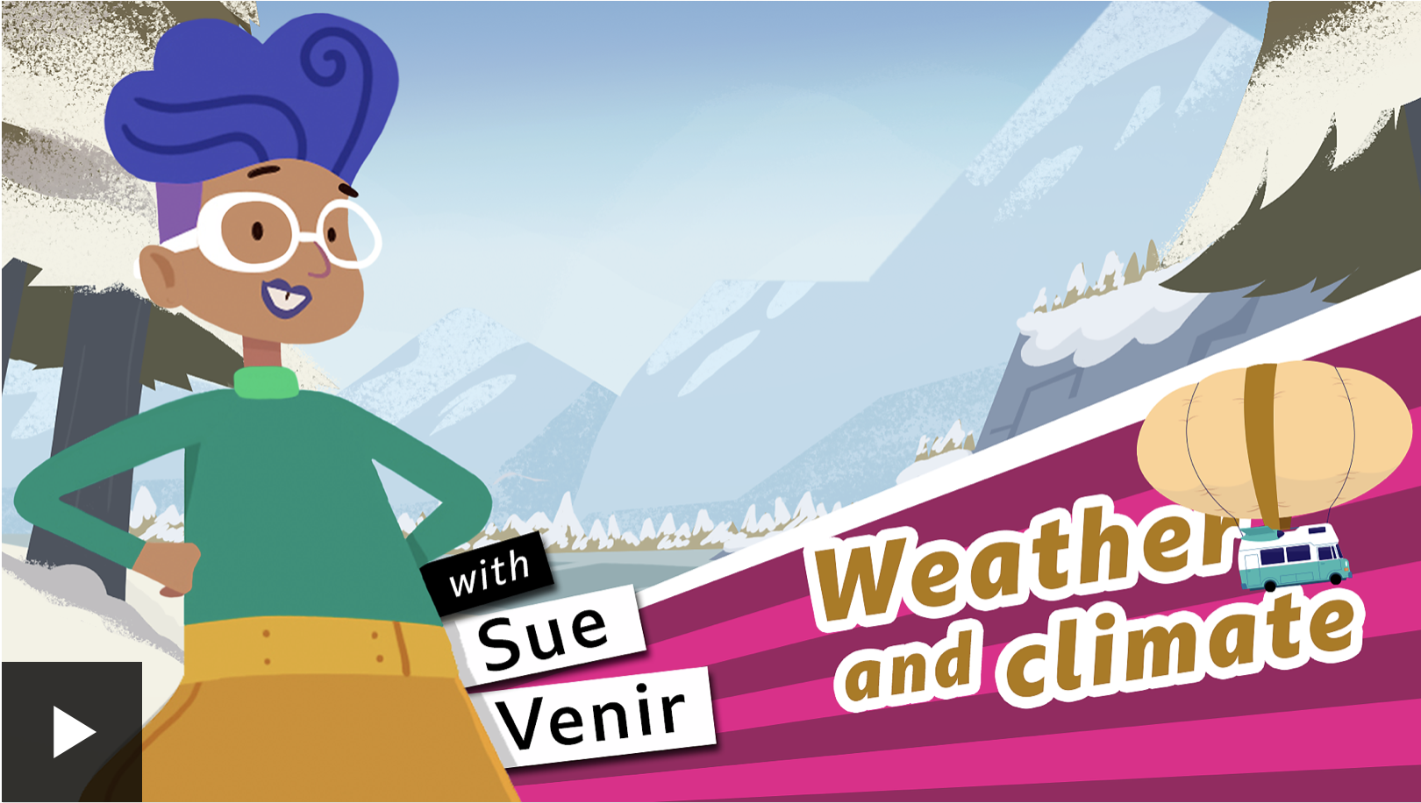
Weather and Climate
https://www.bbc.co.uk/bitesize/topics/z849q6f/articles/z7dkhbk
Notes:
https://www.bbc.co.uk/bitesize/topics/z849q6f/articles/z7dkhbk

Slide 6
Climate Zones
Biome
Description
Example
Polar
Very cold and dry all year round
Antarctica
Temperate
Cold winters and mild summers
UK
Arid
Dry and hot all year round
Sahara Desert
Tropical
Hot and wet all year round
Brazil
Mediterranean
Dry, hot summers and mild winters
Spain
Mountainous
Very cold, sometimes wet, all year
Himalayas

Slide 7
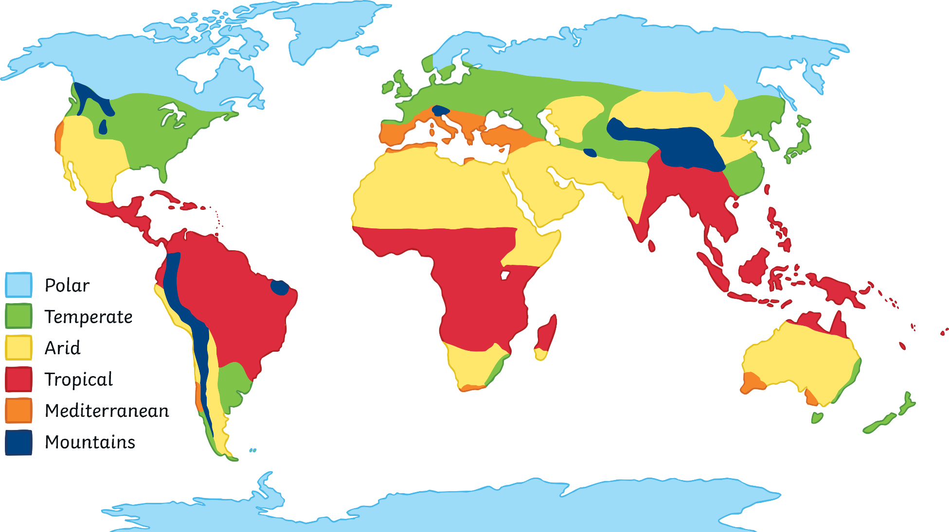
Climate Zone Location

Slide 8
Activity
Using an atlas (or the internet), research different climate zones around the world and look at how climates change around the poles and the equator.

Slide 9
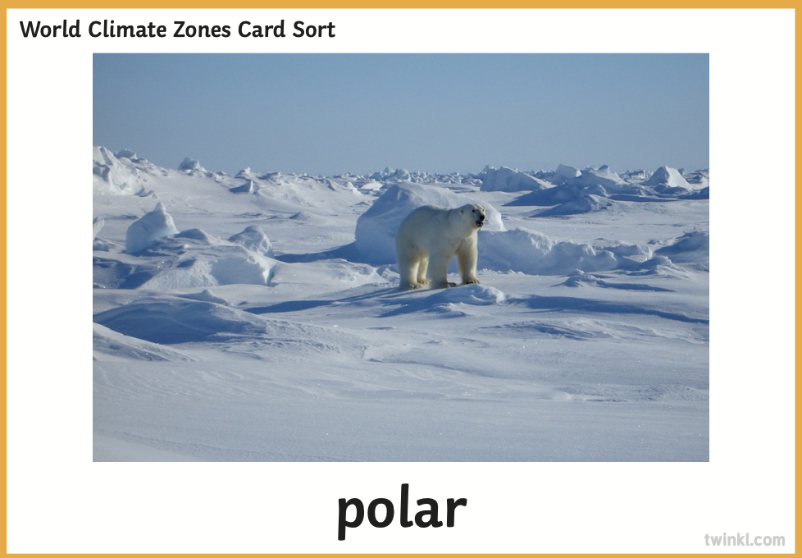
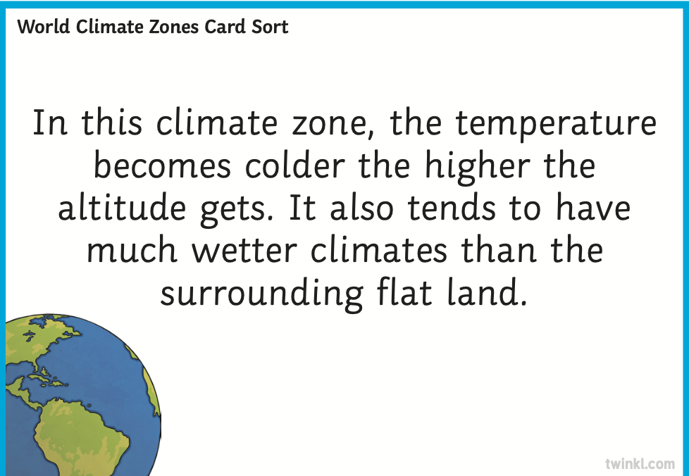
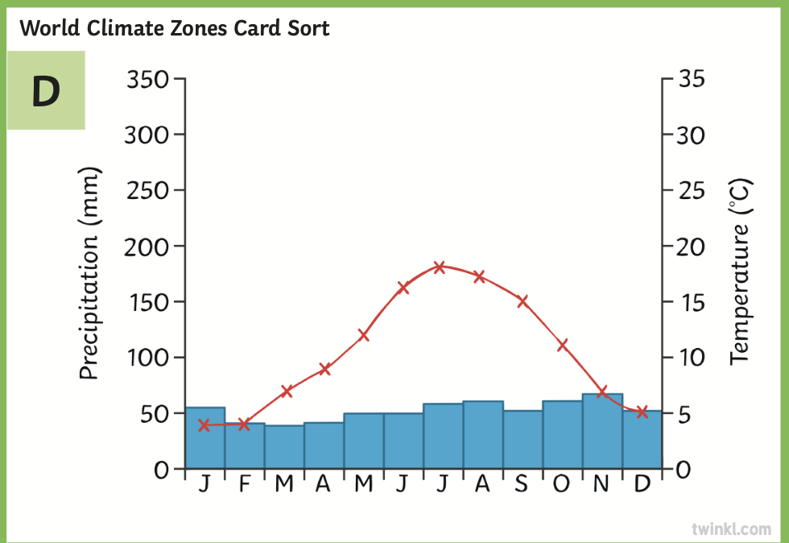
Can I identify climate zones?
Activities:
1. Card Sort Activity. Can you match the picture, explanation and name of the climate zone?
2. Write a brief description of each climate zone using the information from the card sort.

Slide 10
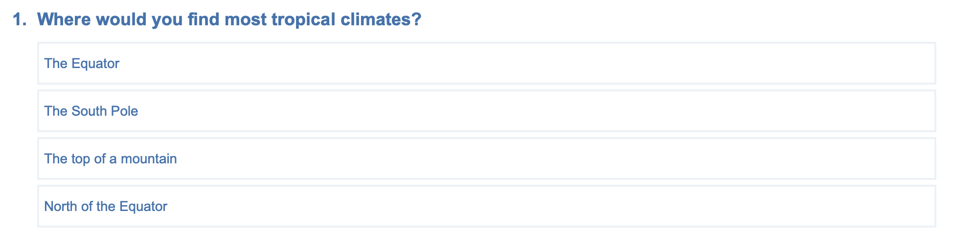
Quiz Time
https://www.educationquizzes.com/ks2/geography/climate/
Notes:
https://www.educationquizzes.com/ks2/geography/climate/
1. The Equator

Slide 11
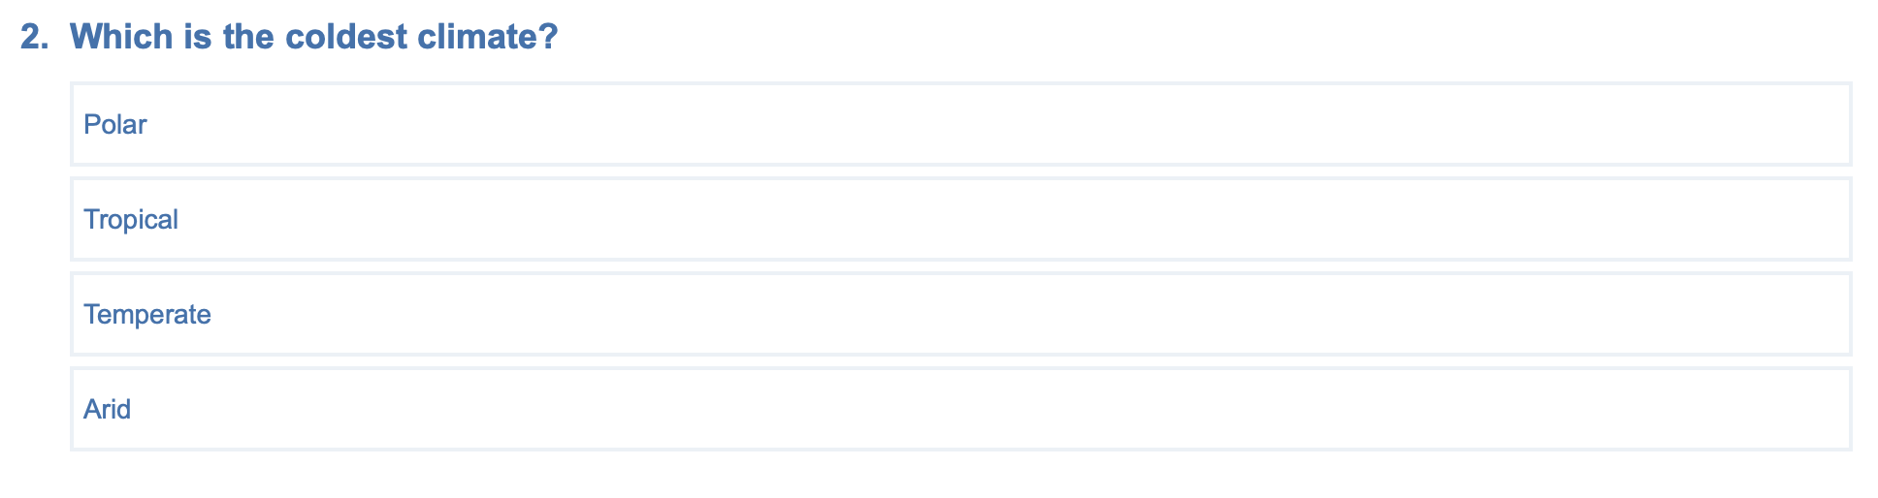
Quiz Time
https://www.educationquizzes.com/ks2/geography/climate/
Notes:
https://www.educationquizzes.com/ks2/geography/climate/
1. Polar

Slide 12
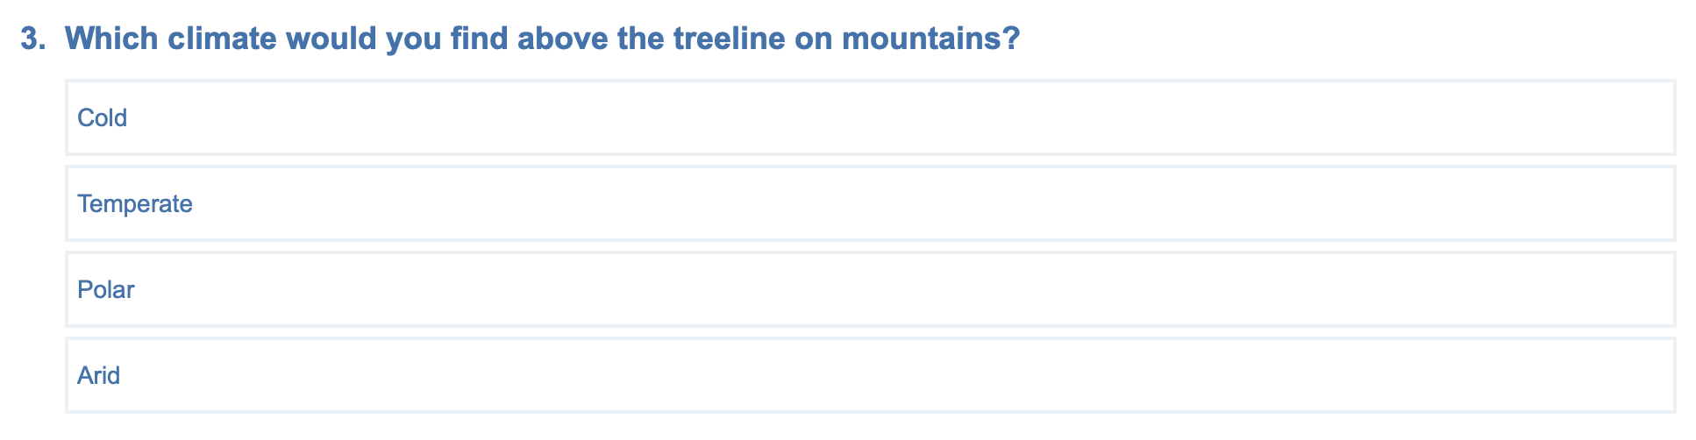
Quiz Time
https://www.educationquizzes.com/ks2/geography/climate/
Notes:
https://www.educationquizzes.com/ks2/geography/climate/
1. Cold

Slide 13
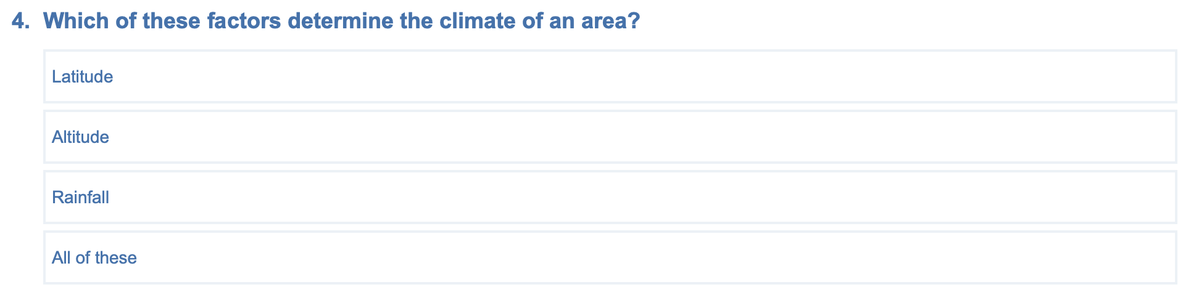
Quiz Time
https://www.educationquizzes.com/ks2/geography/climate/
Notes:
https://www.educationquizzes.com/ks2/geography/climate/
4. All of them

Slide 14
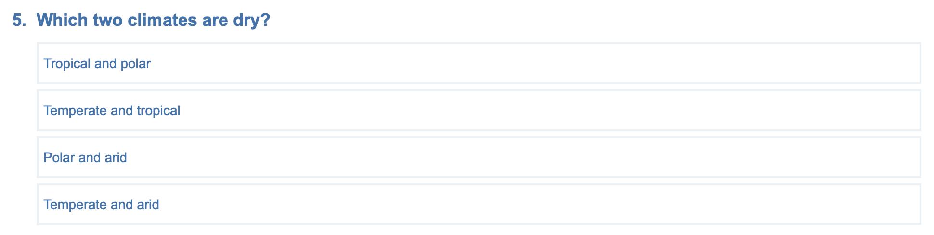
Quiz Time
https://www.educationquizzes.com/ks2/geography/climate/
Notes:
https://www.educationquizzes.com/ks2/geography/climate/
3. Polar and Arid

Slide 15
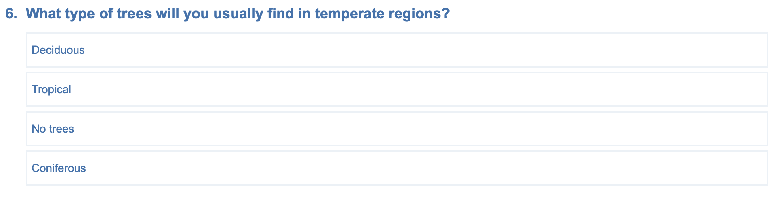
Quiz Time
https://www.educationquizzes.com/ks2/geography/climate/
Notes:
https://www.educationquizzes.com/ks2/geography/climate/
1. Deciduous

Slide 16
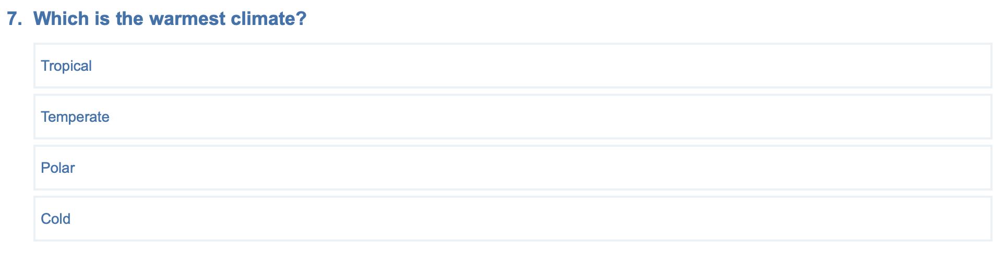
Quiz Time
https://www.educationquizzes.com/ks2/geography/climate/
Notes:
https://www.educationquizzes.com/ks2/geography/climate/
1. Tropical

Slide 17
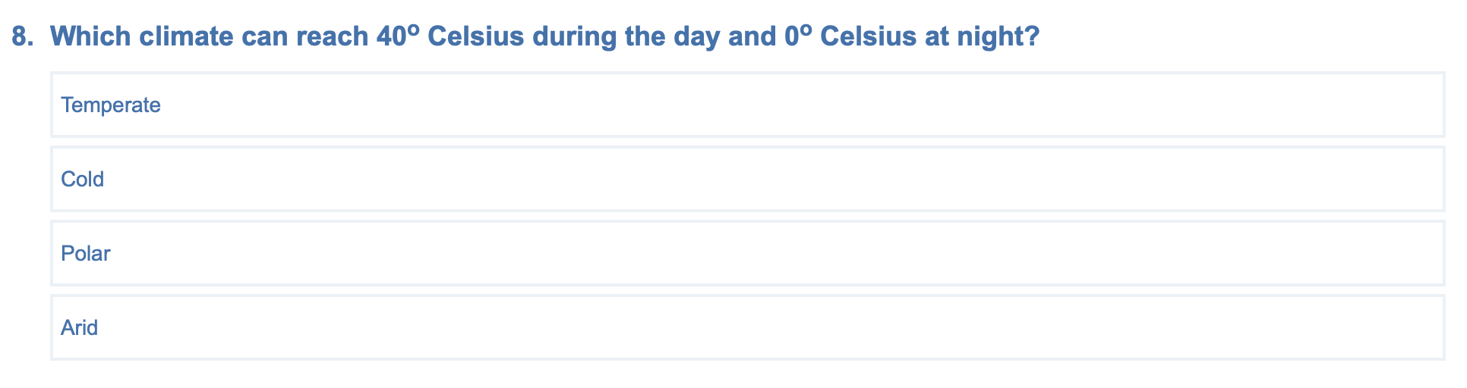
Quiz Time
https://www.educationquizzes.com/ks2/geography/climate/
Notes:
https://www.educationquizzes.com/ks2/geography/climate/
4. Arid

Slide 18
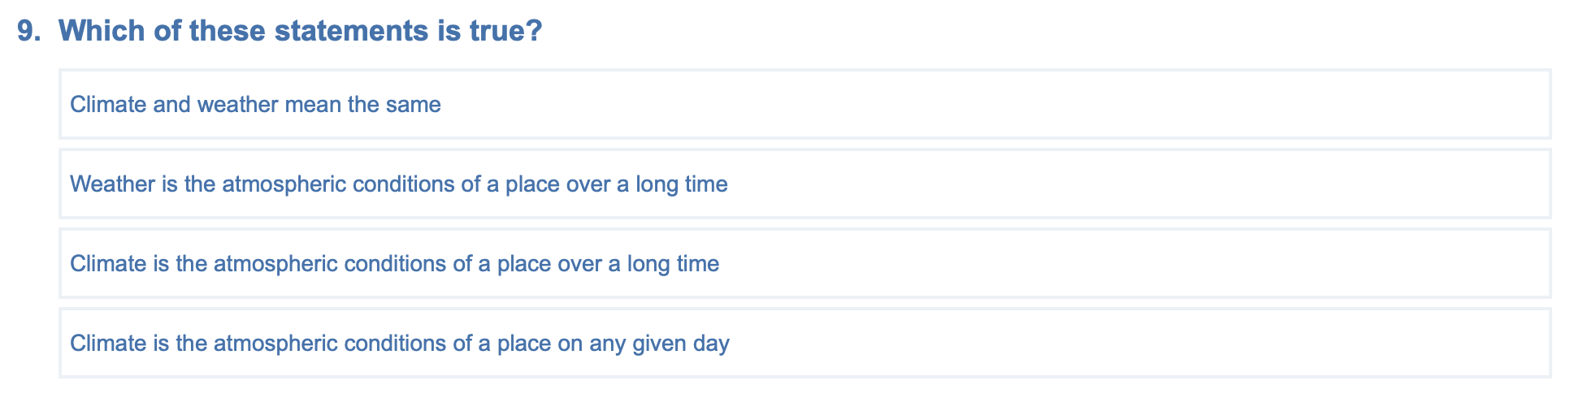
Quiz Time
https://www.educationquizzes.com/ks2/geography/climate/
Notes:
https://www.educationquizzes.com/ks2/geography/climate/
3. The weather is the atmospheric conditions on a particular day and it changes - for example, snow one day and hot sunshine another

Slide 19
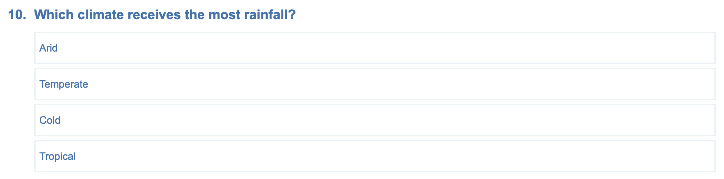
Quiz Time
https://www.educationquizzes.com/ks2/geography/climate/
Notes:
https://www.educationquizzes.com/ks2/geography/climate/
2. Tropical

