Slide 1
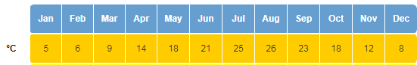
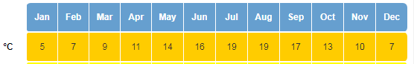
Japan
United Kingdom

Slide 2
WALT: compare Japanese and UK climates

Slide 3
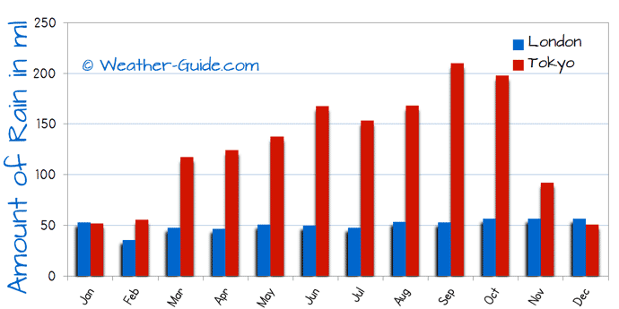

Slide 4
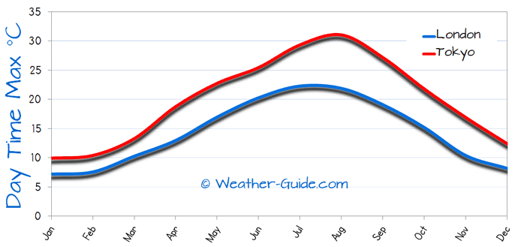

Slide 5
You are going to use the tables to create a graph that compares the climates in both countries.
It must be labelled and colour-coded correctly.
Following this, you must write a short comparison explaining what you’ve noticed – use contrasting conjunctions!
whereas however but

