Slide 1


Problem Solving and Reasoning Questions and Answers
Number-Fractions
Commissioned by The PiXL Club Ltd.
June 2017
This resource is strictly for the use of member schools for as long as they remain members of The PiXL Club. It may not be copied, sold nor transferred to a third party or used by the school after membership ceases. Until such time it may be freely used within the member school.
All opinions and contributions are those of the authors. The contents of this resource are not connected with nor endorsed by any other company, organisation or institution.
© Copyright The PiXL Club Limited, 2017

Slide 2
Guidance
These problem solving and reasoning questions and answers have been taken from our therapies. They have been grouped according to subject for your convenience. However, when sharing them with pupils, it is important to mix the problems so that pupils have to decipher which area of maths they will have to use to solve the problems.

Slide 3
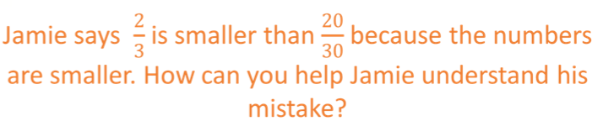
These diagrams prove that 2/3 and 20/30 are equivalent fractions.

Slide 4
There are 360 people in a school. 20 of them are teachers. What fraction of the people are teachers? Write the fraction in its simplest form.
20/360 = 2/36 = 1/18

Slide 5
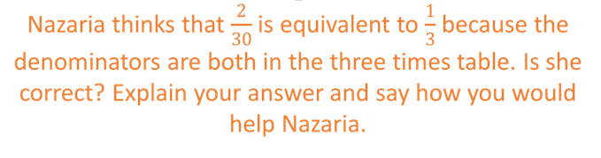
These diagrams show that 2/30 and 1/3 are not equivalent. 1/3 is equivalent to 10/30 which is greater than 2/30

Slide 6
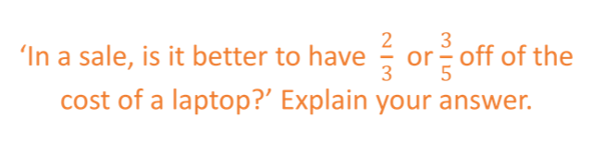
It is better to have 2/3 off of the cost of a laptop because 2/3 is greater than 3/5.
We can prove this by converting both fractions so they have a common denominator.
So, we can see that 2/3 is greater than 3/5
2/3 = 10/15
3/5 = 9/15

Slide 7
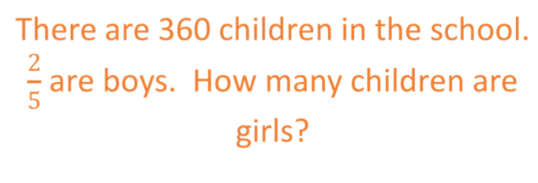
216

Slide 8
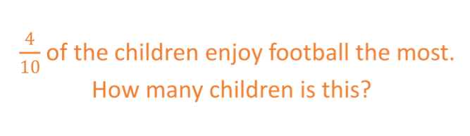
There are 360 children in the school
144

Slide 9
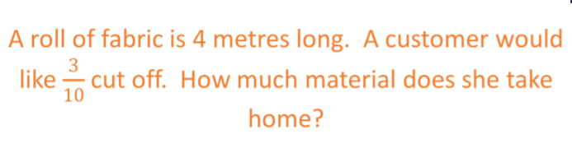
1.2m

Slide 10
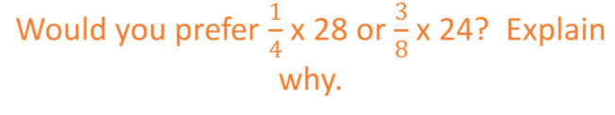
¼ of 28 = 7
3/8 of 24 = 9
It is better to have 3/8 of 24 because 9 is more than 7

Slide 11
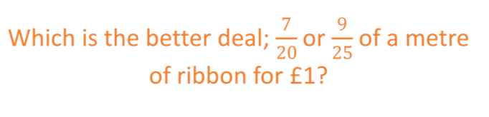
To compare the fractions, we can convert them to equivalent fractions with a common denominator
It is better to have 9/25 because this is a larger fraction than 7/20.
7/20 = 35/100
9/25 = 36/100

Slide 12
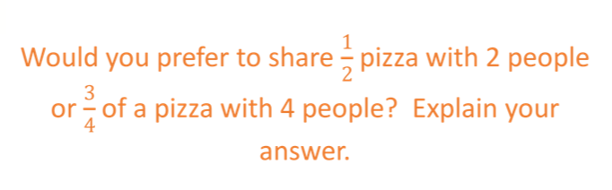
It would be better to have ½ a pizza between 2 because you would each get ¼.
¾ shared between 4 is not even ¼ each.

Slide 13
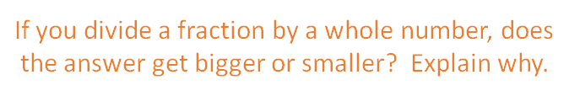
The answer would be smaller because if you divide ½ by 2, for example, you would get ¼ and ¼ is smaller than ½

Slide 14
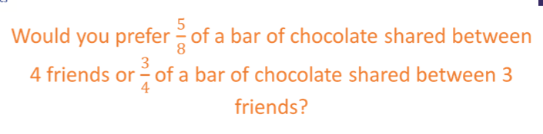
To firstly compare the fractions, we can convert them so they have a common denominator
5/8 between 4 friends
¾ = 6/8 between 3 friends
It would be better to share ¾ between 3 friends because we can see that ¾ is greater than 5/8 and there are less people to share a larger amount

Slide 15
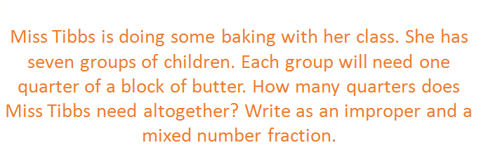
7/4
1 ¾

Slide 16
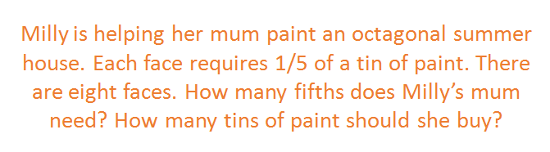
Is 1 and 3/5 so Milly’s mum needs 2 tins of paint.
8/5

